Slide 1


The effects of Covid-19 on tv watching habits
NMHH-MEME 2020 Research – additional qualitative module

Slide 2
Research background

Slide 3
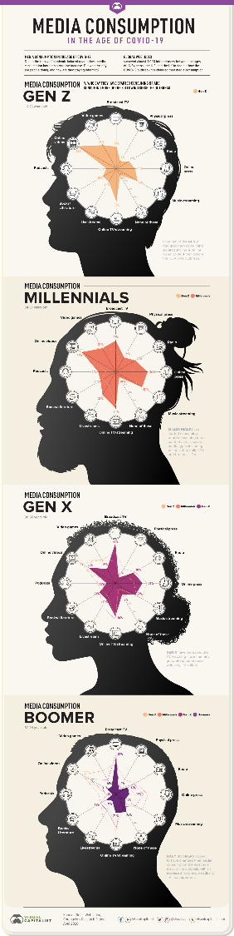
Research background
Why is the research needed and what we can learn from it?
The first cohort research in the television industry has been launched in 2017, among 15-29 y.o., as a part of the NMHH-funded industry research of MEME. The second wave will take place in 2020, i.e. this year, as originally planned.
As it basically determines the year 2020, we want to examine the impact of the Covid-19 epidemic in a separate, complementary study, in addition to quantitative measurement.
The complementary module basically seeks the answer for the question: how have young people changed their audiovisual media usage patterns as a result of the epidemic. Although the Nielsen data show how much more people watched TV, and for what kind of TV content the demand grew better, the motivations and choices behind them cannot be clearly deduced from these data. Through this research, our task is to map and understand these, with a particular focus on platforms not measured by Nielsen.

Slide 4
Research design
Who we asked and with what kind of method
Method: online forum discussion (see introduction and main parameters of the method on the following slides)
Length: 3 days
On the closed and secure platform of Ipsos, which is specially developed for such conversations, the discussion can be continuously monitored also by MEME stakeholders
Target: 18-32 y.o. and 33-49 y.o. men and women, with at least intermediate education level and at least average income. They are open to share their thoughts and emotions on their media consumption habits, they are ready to talk about this topic. All of them are watching TV regularly, also in peak time. Linear TV is present in their life, however, they also consume media content using other platforms (VOD, SVOD, online stream, etc.). They do not reject advertisements and commercials. They perceive that COVID-19 has brought some changes into their habits on media consumption, esp. TV watching.
Sample: 18 participant

Slide 5
About the method
Online forum discussion
An interactive, chat-based method, that combines the dynamism of focus group discussions with the opportunity of deep understanding provided by personal interviews. Participants answer questions and interact with each other in a written form.
In a forum discussion, participants are not present simultaneously, but they sign in at least two times a day, with a schedule appropriate for them, and spend at least 30 minutes answering the questions each time
We might apply a full (participants won’t see the answers of others), or partial masking (participant would see the answers of others after submitting their own answers)
We can set questions as obligatory, which means that participants cannot go forward without answering the particular question
There is an option for making shorter voting (single or multiple choice closed questions) among participants, where we can understand the reasons behind their choices from the comments added to the vote
Segmentation is also possible, so that we can add filtered questions for each subgroups or segments, which is only visible and answered by that particular group
The platform provides opportunity for sharing any formats (pictures, videos, text concepts) of test materials, that the participants would evaluate. It works also reverse: participants may also share photos or videos, which enriches their answers

Slide 6
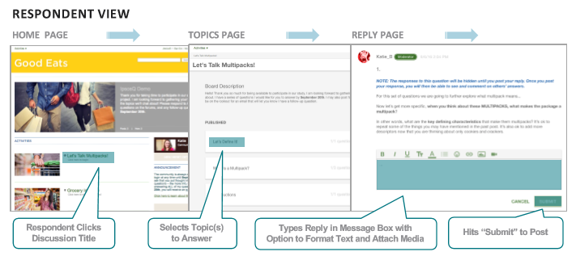
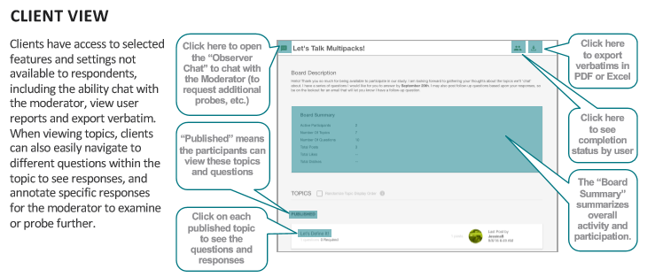
About the platform
What respondents and MEME stakeholders see on the platform
The platform is accessible by using different devices: mobile, PC, laptop, tablet
The language of the discussion is Hungarian
Participants can log in anytime and from any locations that are convenient to them, it is not limited
The entirety of the discussion will be visible onscreen 24 hours a day, MEME stakeholders are in a ‘virtual backroom’, where they can make observations, discuss findings and keep contact with the moderator

Slide 7
Main topics of the forum
We had thematic blocks of questions for each days of the forum
Day 1
Understanding the TV watching habits within the household: who, when, where and with whom
Role of the TV before COVID-19
Preferences regarding channels and programs
Day 2
Changes on TV watching habits and role of the TV during the quarantine
Important contents during quarantine, main audiovisual experiences connected to the epidemy
Effects of quarantine on the choice of content
Understanding the ground of changes
New contents and platforms during COVID-19
Day 3
Change of TV watching habits after the quarantine
Expectations for the future – What would remain from the new habits developed during COVID? What would return from the times before?
Role of the TV after the quarantine

Slide 8
summary

Slide 9
Changes on tv watching habits
While TV watching habits only changed temporarily, the openness towards alternative platforms shows a more stable growth
Although the role of TV raised significantly during the quarantine, we can observe a returning tendency after the resolution of restrictions:
During the quarantine, TV has served two main functions: to fill the many extra time (functional) and being a frame for the common moments of family members (emotional)
However, after the quarantine, parallel to the resolution of restrictions, the functional role of passing the time has been overshadowed, and respondents are more likely to be in community or spend time in the nature again
Its emotional function has remained, but it needs to share with other activities representing valuable spending of time
This way, multimedia consumption seems to return to the level of the times before COVID, or even undergoes it
Changes regarding channels and program categories don’t seem to be long-lasting:
Changes of TV consumption mainly affected the time spent watching TV and the circumstances (place, people) during quarantine, while the preferred channels and programs were less concerned
On the other hand we found two contrary drives:
Immersion: searching for data and content that informs about the epidemy
Counter: choosing content that help forgetting about the actual circumstances (e.g. series showing ‘normal’ life), avoiding such contents that remind on them (e.g. disaster films)
The role of alternative platforms, which has been strengthened during COVID, seem to stay stable after quarantine:
The increased time spent of media consumption during quarantine, and – for some – avoidance of specific contents both encouraged the trying or more intense usage of alternative platforms, especially Netflix and HBO Go
During their usage, viewers could connect clear benefits to these platforms (on-demand content, being free of advertisements), which bring them to keep their new habits
Respondents subscribing to paid online platforms would stand with their decisions after the resolution of restrictions as well

Slide 10
The effects of Covid-19 on tv watching habits
How respondents have perceived the role of television before, during and after the quarantine
Before COVID, the main functions of watching TV were: evening and weekend relaxation, receiving information, and entertaining children. During the quarantine, not only the time spent on watching TV, but also its importance has increased. The informational function came into prominence, while other meanings have been associated to this activity as well, like being the frame of togetherness, or the tool for exiting reality. After the resolution of restrictions, a strong need for outdoor, and/or social activities emerged, so that TV has been temporarily neglected – however, majority expects to return to the former level (before COVID) when the autumn, or the second wave of COVID comes.
Did the quarantine effect on the circumstances of watching TV?
While respondents haven’t perceived spectacular changes in their TV watching habits, their answers show that the duration has significantly risen, which is partly based on the background ‘watching’ during daytime. Meanwhile, the duration of evening watching has also changed: both due to the earlier starting and the later ending. The relevance of common watching has grown, as respondents found it more important to spend their freetime together – and because of this, they were more open to give up their own program preferences. It was not typical to have new additional devices, but the reconsideration of placement, even using the older devices again.

Slide 11
The effects of Covid-19 on tv watching habits
What type of contents did they perceive as more relevant during the quarantine? Did they have any important audiovisual experience that they definitely connect to the period of epidemy?
During the quarantine, especially at the beginning, searching and following of news and talk shows concerning the virus topic have been in focus. On the other hand, as the time went on, the increased rate of programs, announcements and advertisements concerning COVID has led to a surfeit for some, so that they started to avoid such contents – which also strengthened the openness towards alternative platforms. The need for some program categories already being popular before – like movies, series or cartoons – have further grown, as these programs helped people to exit reality for some hours. Some new categories and channels also appeared in respondents’ lives temporarily. Meanwhile, some started to avoid programs with negative tone. The lack of live sportscasts drove the viewers from sport channels to other alternative programs.
How did the quarantine affect the usage of alternative platforms? Is there any that they started to use exactly during the quarantine?
The increased duration of media consumption also supported the penetration and more intensive usage of alternative platforms. Both the problems perceived in accordance with TV (which have been faced more regularly), and (for some) the surfeit towards COVID contents strengthened this tendency. Respondents chose mainly paid online video services, especially Netflix and HBO Go. The users of these services are planning to keep their subscriptions, or utilize them better, even besides the decreased weight of watching TV.

Slide 12
Detailed results

Slide 13
Watching tv before covid-19

Slide 14
Dear TV, I am addicted to you! You are present in my everydays, when you look after my children, sometimes you entertain me, or help us relax with my partner. The rumor, talk-show or lifestyle programs make you be also my best friend. Kisses XX
Woman, 28, Budapest
Dear TV, I would like to tell how much you mean in my life. You are present in it almost every day, and I hope it will last for long. I never told, but you make me laugh or cry many times, and I also often flutter for you. Life would be more boring without you, and I would receive less news from the world. Although there are times when you show less novelties, you are very important for me. I am glad that you are with me.
Man, 43, Székesfehérvár

Slide 15
Role of tv before covid-19
Albeit the TV had an important role in the household even before the quarantine, respondents were more critical, and turned easily to alternative activities
From the confessions written by respondents we can see that the main functions of watching TV were before the COVID-19:
Entertains, makes me laugh
Enchants me, engages me
Provides information, news
Helps me resolve stress
Relaxes me after work/ in the evening
Keeps children busy
Connects family members (watching together)
Background noise for falling asleep
Helps me not to feel alone (background noise)
In case of smart TV, it helps studying (projecting the materials)
On the other hand, there were also problems and complaints to confess:
TV packages contain too many channels, and only a few are real relevant
Several mentioned that traditional channels offer fewer and fewer interesting, relevant programs, and tend to become schematic (having very similar programs)
Channels often broadcast different seasons of the same series parallelly at peak time
Repetitions are also frequent
Movies and series are often interrupted by commercials, which is perceived to be annoying
Some specific programs (like sports and cartoons) derive attention from more important things, like family moments
‘I would like to tell you how grateful I am for the few minutes silence you provide me at evenings.’ – Man, 36, Székesfehérvár
‘Thank you for showing me so many things of the world, like a window wide open.’ - Man, 42, Budapest
‘There were times when I used to turned from you, because I didn’t feel you attractive enough. I better went to the nature, or wanted to see more movies and series which has been available in the Internet.’ – Woman, 29, Budapest

Slide 16


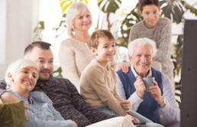
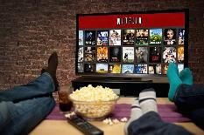
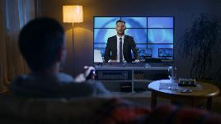
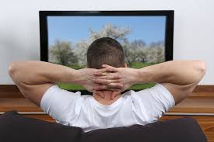

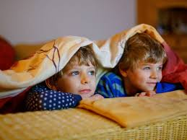
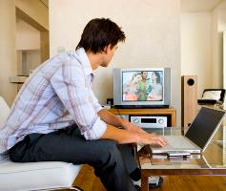

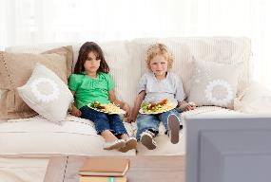



Typical situations of watching tv
COMMON SITUATION
Background noise during a visit
Watching movies and series via alternative platforms
Common jittering – even watching online
Family TV watching at the living room – movies, cartoons, shows
LOW ATTENTION
TV in children’s bedroom
*
HIGH ATTENTION
News in the morning/ evening – only for adults
Documentaries – alone or together
Relaxing while multiscreening
Watching movies/ series/ shows before falling asleep
Background noise – music, sitcom, cooking, documentary
Inspiration for cooking
Watching series on mobiles/ tablets
Me-time after children go to bed – mainly series
Cartoons after nursery/ kindergarten/ school**
*,**: based on parental view: in these situations, TV is the tool of entertaining children, so that parents are not participating
INDIVIDUAL SITUATION

Slide 17
Role and typical situations of watching tv
Before COVID, watching TV with concentration was mainly typical for evenings and weekends, otherwise, it had other functions
Respondents chose their bigger TV packages due to the relevant channels included
For families, Hungarian language cartoon channels had a high importance, so that they are not open towards switching for alternative platforms
Besides this, movie (e.g. Film+, Mozi+, Moziverzum) and sport channels (e.g. Spíler, M4) have been mentioned as affecting choice of package
Before COVID, mainly evenings and weekends have been typical for watching TV, even with family, partner, or alone
In case of children, daytime TV watching is also frequent: it is like some kind of ‘reward’ after their daily tasks (nursery, kindergarten, school), and it is also of help of the parents, as it engages children while they do their tasks at home
‘We have time for watching TV in the evening and on weekends, then we really pay attention. Otherwise it’s just a background noise.’ – Woman, 25, Székesfehérvár
Before the epidemy, common TV watching has been less meaningful, this way, single choice of programs has been also typical (even all family members in different rooms)
In case that family members watched TV together, in most cases they made compromises, or – in case of having children – the choice of the child, or the appropriateness for children has been decisive
Attention has been mostly active when watching movies or cartoons, but in case of other types of programs (e.g. documentaries, sports, series) attention might have been divided, and a parallel activity was common
Out of the mentioned favourite channels, RTL Klub, TV2, and Comedy Central seems to emerge: while RTL and TV2 are favored for their own series, shows, realities, and the overall variety, Comedy Central is welcomed for its humorous series
Movie- and cartoon channels, documentary channels and thematical channels (e.g. Discovery, Spektrum Home, TLC, etc.) have been also mentioned

Slide 18
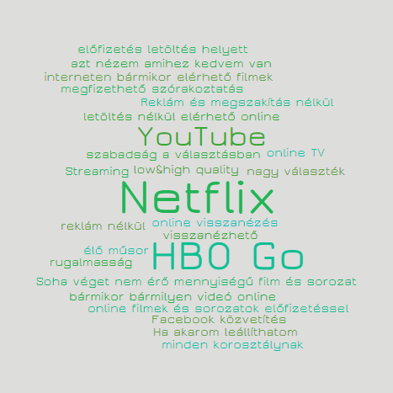
Perception of alternative platforms
Talking about online video providers, majority reflect to paid subscriptions
Out of the spontaneous associations, Netflix and HBO Go emerged, providing paid services
Although YouTube has been also mentioned several times, it has not been connected to ‘free online video services’ category, as they do not perceive it as an alternative for TV
Only two respondents mentioned online TV channels, while the video services of telecommunication providers have not been mentioned spontaneously
One possible reason for that is the low awareness and penetration of these services among respondents
Not all respondents have access to video services of telecommunication providers, so that the couldn’t interpret this category, and some connected availability of the linear TV broadcast via mobile applications (e.g. TV Go, Telenor MyTV) to it
Perceived main advantages of online video services are flexibility, availability (anywhere, anytime), freedom of choice, ad-freeness, and possibility of watching (again) later
‘This is the century of streaming!’ – Woman, 25, Székesfehérvár
‘Watching traditional TV broadcast is a program. Online is a spontaneous form of entertainment.’ – Man, 48, Debrecen

Slide 19

Alternative platforms before covid-19 – free online video services
Free video services were present in respondents’ lives right before COVID, but they play a different role compared to TV
Advantages of the free platforms (YouTube, series streaming platforms) – besides being free – are freedom of choice, availability (anytime, anywhere, using any device, for anyone), and the opportunity of saving favourites/ videos to watch later
Main disadvantage is the high quantity of advertisements, which might seem disproportionate in case of short videos, but might be avoided in case of subscription
Lower image quality has been slightly mentioned as a ‘fee’ for being free
The most frequently used free platform, YouTube has an additional advantage of being watched on smartTVs conveniently, unlike other free online platforms used for watching series
On the other hand, the respondents connect the consumption of shorter videos to it, which are better watched on mobile devices. With these occasions, such situations are associated that are less convenient compared to traditional TV watching
Respondents admitted watching shorter video contents (e.g. recipes, product demos, contents regarding computer games, ‘How it is made’ videos, humorous videos), and listening to music to this platform
Downloading movies has been also mentioned as part of the free online video services – in this view, it would be competitor of both traditional TV and paid online platforms (free, no advertisements, stoppable, rewindable, etc.)
‘I can even watch it on public transport, or if I stop for a few minutes to take a rest.’ – Woman, 29 Budapest
‘I can better bear the commercials in the TV, than a sudden ad in a short video.’ – Woman, 27, Debrecen

Slide 20
Alternative platforms before covid-19 – paid online video services
The importance of paid services has grown during the quarantine
Before the quarantine, the majority did not, or only less frequently used paid online platforms, as linear TV watching could better fill the shorter media consumption time
Paid services – just like the free ones – provide the opportunity of free choice, but they have a different role in media consumption: they mainly serve movie and series watching
In terms of movies and series, they have the widest and most up-to-date offer compared to the available platforms
Series episodes are unlimited to watch
Own productions are also appealing to subscribers
In exchange for the subscription fee, these platforms are ad-free and provide a high image quality
They are practical to use: easy searching, recommendations, they continue playing content from the point it has been stopped, etc.
However, having some contents only in a foreign language is both an advantage and a disadvantage (depending on the viewer and the situation)
‘Before COVID, we used HBO Go a bit less. Maybe because we used to be more free, we could go out and we didn’t need to spend our freetime at home after work.’ – Woman, 27, Debrecen
‘The service adapts to me, and not reverse.’ – Man, 29, Debrecen
‘I started to watch some of the movies and series because the TV suggested them, and I must say that the algorithm worked!’ – Woman, 25, Székesfehérvár
‘What I could mention as a contra is that sometimes we start watching series and we than we find out that episodes have not been synchronized.’ – Man, 22, Budapest

Slide 21

Alternative platforms before covid-19 – online TV
TV channels available online and video services of telecommunication providers had a low penetration even before the quarantine
Both in term of awareness and willingness to use, TV channels available online and video services of telecommunication providers have been overshadowed by free and paid online services
The online TV channels and the video services of telecommunication providers have not been widely spread, neither before the quarantine
The advantage of the video services of telecommunication providers are the opportunity to choose freely, and the convenience of watching, which is similar to traditional TV watching – BUT: without advertisements
Their drawback is that both availability and offer depends on provider
Some did not know, or couldn’t interpret this category – they associated it to the linear content watched on mobile devices (e.g. TV Go, Telenor MyTV)
The main advantage of online TV channels is that one can watch the linear broadcast even during the daytime, at work, at a bar, or on the way, which is the most important in case of live programs (e.g. news, sportscast, report on COVID situation)
Another important function is to watch missed programs, movies, series episodes
Single mention: watching sportscasts of TV channels not available in package
Disadvantages compared to the traditional TV watching were dependency from the quality of Internet connection, and the fees of some channels
‘I used to watch it on mobile, when I wanted to watch something that was important to me, e.g. sportscast on M4.’ – Man, 33, Budapest
‘‘It has to be useful to watch the missed programs later.’ – Woman, 29, Budapest

Slide 22
Watching tv during covid-19

Slide 23
Dear TV, I would like to tell you that you have been a fix point of our life even during the quarantine. When we lacked the opportunity to go hiking, or to the cinema, you were there to entertain us. With you, we could get virtually to places, where we couldn’t go during the quarantine. You brought us the news from the world, and you kept us informed about the current situation. I hope you are not angry with us because of not paying attention during the day, using you as a background noise, and because we can spend less time with you after the quarantine. I can assure that we count on you also in the future!
Dear TV, during the quarantine, our relationship got more serious, and I would like to thank you for being my shelter. Sometimes you showed a bit too much about quarantine and COVID, but we always found a solution and made a compromise choosing another program...
Man, 33, Budapest
Man, 24, Budapest

Slide 24

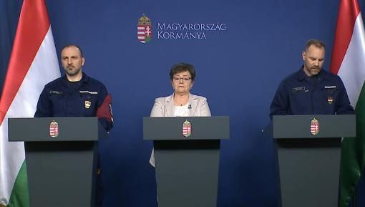

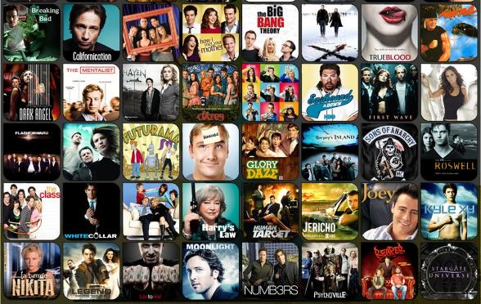

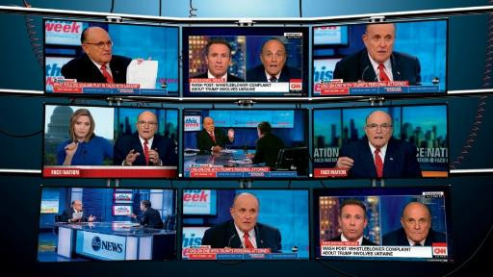

Crucial tv watching experiences during the quarantine
Immersion into the reality
Counter, fleeing from reality

Slide 25
Changed role of watching tv
Circumstances of watching TV have not, or have only briefly changed, but the duration has increased significantly
Physical circumstances
Based on the answers of respondents, they have not made any significant changes neither in the way of watching TV, nor in their subscriptions or the number of devices, it was more typical to reconsider the placement of devices, even using old devices again
TV packages have not changed in most of the cases, but the options have been expanded with alternative platforms, especially subscriptions for Netflix or HBO Go
For those living elsewhere during the quarantine (e.g. by parents), the available package or the number of devices might have changed, which of course affected the chosen content as well
BUT: The decisions made on new devices and expansion of packages might have been influenced by the financial uncertainty during COVID – in this period, bigger expenses demanded deeper consideration
Situations of watching TV
Typical situations of watching TV overall remained, however, their duration and frequency have increased
Due to this, the typical TV watching time started earlier
For those who could indulge it (because of losing their jobs temporarily, or having a more flexible working schedule in home office), a new situation of morning/ forenoon TV watching, or even – due to waking up later – the late night movie watching appeared
The only situation disappearing was the common watching with friends and distant family members, however, it was not very typical even earlier
‘The time spent on watching TV increased, as we didn’t have any alternative programs. Except the daily walks, we were locked into our flat. This made us watching TV not only for entertainment, but to pass the time.’ – Man, 33, Budapest

Slide 26

Changed role of watching tv
Watching TV was not only an important source of information, but also the occasion for togetherness
While TV watching situations have not changed significantly, there was a stronger focus on togetherness
One result was that people were more open to watch shows they haven’t before for the sake of their loved ones
Meanwhile, having longer time for watching TV, and not necessarily being at home at the same time as other family members, alone watching was also present during quarantine
TV has been also present as a background noise – several reported having the TV on during other home tasks (household chores or even work at home office)
Informing function of watching TV had an increased importance, and there was a stronger need for news – especially at the beginning of the quarantine
BUT: there was also a contrary effect later on during the quarantine: after the increased consumption of news at the beginning, some started to avoid news, reports and advertisements concerning COVID as they found them exaggerating
Some also perceived the increased rate of such contents as scaring
‘We only sat down together, until now, the occasions of watching TV alone have disappeared.’ – Man, 29, Debrecen
‘As I was at home during the quarantine, I watched TV more often, it was on during the day, not only when my partner got home.’ – Woman, 26, Székesfehérvár
‘We used to watch more news, but that many Corona-thing, and the unsettling, attention-grabbing news made us stressed.’ – Woman, 25, Székesfehérvár

Slide 27
Changed role of watching tv
There have been temporary changes in terms of channels and programs
‘I definitely got addicted to interior design programs. They took me back to the everydays, provided tips, and I felt myself developing. Somehow it made me feel as if I lived my normal life.’ – Woman, 28, Budapest
‘Somehow I didn’t fancy watching the good old war-themed documentaries,, there were so many negative things around the world, so that I neglected documentary channels.’ – Man, 24, Budapest
‘I used to watch more Hungarian series and also the Fókusz during quarantine, as we were at my parents’, but I gave them up when we got back. In that situation, I enjoyed watching them together with my mum, while chatting with her.’ – Woman, 39, Budapest
‘It became boring, that they broadcast the same things continuously, or 10 years old seasons from popular series.’ – Woman, 25, Székesfehérvár
Besides relaxation, a new function of watching TV emerged during the quarantine: breakaway from reality, getting back into the ‘normal’
Due to this, respondents watched even more movies, comedies, sitcoms, side-splitting programs, etc.
Some also reported avoiding negative topics (like war, disease), documentaries and disaster films
Some programs also appeared on respondents’ schedule, that have been neglected before (due to schedule or the lack of interest towards program category)
However – mainly for male viewers – sport channels have disappeared, or their weight became lower, as live broadcasts of sports events were not available
Evaluation of former problems with linear TV watching showed two routes:
Some were a bit more forgiving and patient, because they had no alternative freetime activities. Nevertheless, they might have discovered new opportunities in accordance with the TV (channels and program categories neglected before), however, they don’t expect these novelties to stay stable in their lives
Others faced these problems much more often (e.g. seeing too many advertisements, too many repetitions, etc.) and were more likely to turn to alternative platforms, especially Netflix or HBO Go. These platforms mainly replaced the movie and series watching on traditional TV channels, providing the advantage of watching these limitless, without ads

Slide 28
Alternative platforms during covid-19
Quarantine led to the strengthened role of paid online video platforms
The increased time spent on watching TV during the quarantine (as having no alternative programs) also meant the higher usage rate of alternative platforms
While the increased watching time would be enough on its own to encourage increased usage, - for some – the former problems with traditional TV (too many advertisements, too many repetitions, too many contents concerning COVID, etc.) and this way, the disappointment in it also supported this tendency
Usage rate of free platforms has not changed significantly, however, due to the quarantine, the function of watching movies on YouTube also appeared
Meanwhile, some viewers reported increased rate of COVID-concerning contents and advertisements on YouTube as well, which could also discourage those fleeing from such contents
Usage of paid online video services has appeared or increased in the everydays of the majority
Concerns about linear TV watching (e.g. advertisements, repetitions), and the increased free time that could be spent on watching both motivated usage
Opportunity of free trial motivated new subscriptions
One respondent reported change in the offer of paid services: more synchronized content appeared on these platforms
On the other hand, usage of online TV channels have decreased, as live broadcasts could be followed right at home, and programs were rarely missed as having less of other alternative programs
Common watching of sports events disappeared due to the regulations aiming social distancing
Those not working in home office kept following the live broadcasts of news online
‘As we spent more time at home, I didn’t miss my programs on normal channels.’ – Woman, 29, Budapest
‘We watched the TV most often, but the quality movies and series have been missing. We needed quality video content, and not only the free services.’ – Woman, 29, Budapest

Slide 29
Watching tv after covid-19

Slide 30
Dear TV, now, in the summertime we cannot be with you as much as we would like to, but as autumn comes, it would change again. We will spend more time in front of you, with some mulled wine. I am looking forward to it. I cannot promise anything for the future, but I hope that our relationship will be stable! An honest admirer of yours
Man, 36, Székesfehérvár
Dear TV, you have been a shoulder in bad times, and a friend in good times. However, we soon have to say goodbye. It was a beautiful period for both of us, but I can spend quality time with other things as well. I try to spend my weekday evenings with you, but please, don’t expect me to be with you in the weekends as well. I couldn’t make it... Sometimes you are too much for me, and I miss my previous life... Nevertheless, I have someone new in my life, her name is Netflix. She is new, fresh, dynamic, interesting, young. I am not trying to break up with you, please, don’t misunderstand it! 🙂 But our relationship has come to a point of change!
Man, 24, Budapest

Slide 31

How we see the tv now
The role of the TV lost on importance after the release of restrictions
Both the experience of being locked down, and the nice summer weather discourages people from watching TV
The unavailability of alternative, outdoor activities during the quarantine increases the demand for such programs after the release of restrictions
This tendency is strengthened by the ‘surfeit’ caused by the increased rate of watching TV during quarantine
Besides this, the quarantine also highlighted the importance of togetherness, which raised the demand for social activities
The spring/summer weather also motivated respondents to leave their homes and neglect TV
For some, the release of restrictions also mean the return to the work (in case that they couldn’t work during the quarantine), which also influences the decreasing time spent on watching TV
Despite this, respondents expect themselves to return to the previous level of watching TV when the autumn comes (partly due to the bad weather, and partly due to the second wave of COVID, which is expected by several)
‘Now, as the weather is good, we spend more time outside, and we usually get home so late that we don’t even turn on the TV. Probably when the weather gets worse, we will return to our flat and spend more time in front of the TV.’ – Woman, 39, Budapest
‘The work schedule returned to the normal, so that it doesn’t work anymore to watch TV until dawn and then laze the whole day.’ – Man, 48, Debrecen
‘Currently we watch TV less often due to the summer. We will see what happens in the autumn. Maybe we will watch more TV, but maybe it would be the same as every year.’ – Man, 36, Székesfehérvár

Slide 32
Expectations for the future – what would disappear, what would remain?
Majority of respondents doesn’t plan any changes in TV packages, however, the openness towards alternative platforms grow continuously
Majority of respondents doesn’t plan any changes in TV packages, because of:
Satisfaction with current package (in some cases corresponding with the re-discovery of the package getting to know further channels)
Difficulties of switching (loyalty period, no other providers available, etc.)
Only a few respondents consider expansion, having fears of the second wave of epidemy:
Expanding TV packages
Having additional devices
Those who started to use alternative platforms or used them more often consider keeping and better utilizing these subscriptions, perhaps with the parallel reduction of TV package
‘We are looking for a smaller TV package, because we do not utilize ‘normal’ TV channels. It doesn’t worth paying for them. We stand with HBO Go and Netflix, moreover, we would appreciate other paid channels (e.g.Hulu) as well.’ – Woman, 39, Budapest
As far as the program preferences are concerned, respondents expect a return to the neglected categories (e.g. documentaries, sportscast), but they also plan to keep the highlighted role of watching movies and series. In case of a second wave of COVID the expect an increased consumption of news again
‘Unfortunately, I got addicted to series during the quarantine, and what I started, I want to finish. Due to my work, it is focused on the evenings, at daytime I cannot spend time on them.’ – Woman, 33 Budapest
‘We keep the well-tried movie channel, and we try to avoid news channels. Only in case that the epidemy returns would we follow news again. ‘ – Man, 43, Székesfehérvár

