Slide 1


TV AND ALTERNATIVE SCREENS
Study Report for MEME
02. 10. 2018.

Slide 2


Content
03
26
Methodology
Ad acceptance and alternative screens
07
32
Demographycs
Parallel activities
10
40
General viewing habits
Primary and secondary screens
16
51
Watching situations
The secondary role of TV

Slide 3
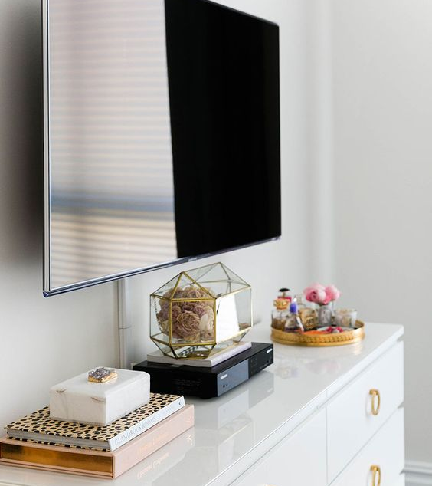

METHODOLOGY

Slide 4
The Scope of the Research
A number of recent, international studies confirm that some consumer segments use multiple screens at the same time. Due to the divided attention, TV could become the secondary screen in some parts of a day, which raises business issues regarding the effectiveness of advertising.
The extent and effects of the phenomenon are yet to be known, while opinions are also divided on to what extent shall the provider conform to these new market demands. The goal of the research project articulated by MEME is to measure the relevance and the extent of simultaneous screen usage in the context of TV watching.
It was the client’s special request that the database be robust, as the application purposes include the foundation of a sales strategy and programming, broken down into the mode and time of watching, the watched content as well as typical demographic segments. The limited budget and the complexity of the expected output, both limit the methodological opportunities.
Ipsos created a research method built on the fusion of qualitative and quantitative methodologies, that helps television companies to create a sales strategy and programming that is appropriate to the emerging demands and habits. With the help of the situation based, large sample research, the demographic groups and their daily routines can be reliably identified. On the other hand, the qualitative methodology helps to unfold the more complex issues and motivations.

Slide 5


5Ws methodological approach
Given the complexity of the goal, the comparability along different dimensions of the results to be guaranteed, Ipsos proposes an event-based approach instead of building an audience based database.
The respondent recalls the last three occasions of watching TV with the help of the standardised 5Ws question block. From 1.642 respondents, we acquired in-depth data about 4.733 watching situations, that is suitable for evaluation according to content, demographics and type of screen, as well as testing occasional correlations. Almost two third of respondents mentioned three different situations within one day, hence the risk of forgetting was minimized.
.
Who and whom with?
When and how long?
P
What content?
Which screen first?
E
Where and which screens?
Notes:
3 fázis magyarázata

Slide 6

Background of the study
TARGET GROUP
18+ Hungarian people who watch TV at least fortnightly
Sample is representative for the above mentioned group along the most important demographic variables, such as gender, age and type of settlement
Sample size: 1.642
METHODOLOGY
CAWI (Computer Assisted Web Interviewing) methodology, respondents were recruited from the panel of Ipsos, Popoulacio.hu via direct invitations. Length of questionnaire was approximately 20 minutes, fieldwork took place between the 17th and 27th of September, 2018.
DATABASE
As a result of the quantitative study there are two data bases, one person and one event based. Size of the event based data base: 4733 programme situation on different days of the week in different times of the day.
ANALYSIS
After analysing the basic distribution of the answers, the significant differences are described along the most important background variables as well. Due to rounding the sum of percentiles can differ from 100%.
Significant differences: the probability of the results being true for the whole of the studied target group is over 95%, which means that the differences in opinions are not incidental.

Slide 7

DEmography

Slide 8
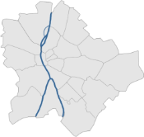
Demographics
50%
50%
50-59
23%
18-29
24%
AGE
40-49
28%
30-39
25%
QUOTA POINTS (fixed ratios)
30% Village | 35% Town | 17% County seat | 18% Budapest
N=1.642 | Base: 18-59 population, who watch TV

Slide 9
Demographics
LEVEL OF EDUCATION
EMPLOYMENT STATUS
SUBJECTIVE FINANCIAL SITUATION
4%
Primary school
72%
Employee
16%
Vocational high school graduation
7%
Housewife
48%
High-school graduation
6%
Self-employed, Entrepreneur
32%
University, college degree
14%
Other
N=1.642 | Base: 18-59 population, who watch TV

Slide 10

GENERAL VIEWING HABITS

Slide 11
Frequency of watching
How often do you watch TV?
Multiple times a day
Every day
Most days
(4-6 times a week)
2-3 times a week
Weekly, fortnightly
33%
44%
10%
9%
3%
The sample contained mostly heavy users of TV, 4 out of 5 respondents watch TV daily. 85% of the over 50 age group watches TV daily, while this number in the under 30 group is 68%. Those in a difficult financial situation enjoy watching TV, according to the numbers 83% of them prefers this activity as a form of relaxation.
N=1.642 | Base: 18-59 population, who watch TV

Slide 12
Frequency of watching
How often do you watch TV in the following times of a day?
Weekdays Weekend
The results validate the methodology, since the frequency of watching shows a similar pattern on both weekends and weekdays, but with a measurably higher PUT level in every part of the day on weekends.
N=1.642 | Base: 18-59 population, who watch TV

Slide 13
Attitude of watching
Wich of the following statements apply to you?
I like to rewatch my favourite movies or series anytime
TV is mostly on only in the background
I mostly look for light and joyful programmes, that help me disconnect
I have my own watching routine, I know when and what I am going to watch
I like to immerse myself in watching TV and concentrate on one program or movie for a longer period
There are some programmes and video content that I usually do not watch on TV
I do not like if someone talks to me whilst I am watching TV
I am looking for new things, I always have a look into the latest programmes
At the end of the day I cannot wait to sit down to watch TV
I prefer short programmes to the few hours long ones
Watching TV is a social activity, it is good to do it together
None of the above
41%
25%
11%
33%
20%
10%
31%
16%
9%
26%
15%
2%
From the top3 mentions it can be concluded that Hungarian TV users prefer relaxing, smoothly flowing programmes to the ones that are new or require attention and concentration.
N=1.642 | Base: 18-59 population, who watch TV

Slide 14
Attitude of watching
Gender and age variables
According to the significance analysis male viewers are less likely to tolerate if someone is talking to them whilst watching TV. The fact, that the under 40 (especially under 30) age group is more open to watch videos on alternative screens, adumbrate generational differences.
N=1.642 | Base: 18-59 population, who watch TV

Slide 15
Attitude of watching
Education and financial situation variables
Respondents without a high school degree are significantly less open to alternative screens, while they also say that they are less interested in easy, short content. There is a similar pattern in the study of subjective financial situation: those with higher standard of living use TV as a form of relaxation.
N=1.642 | Base: 18-59 population, who watch TV

Slide 16
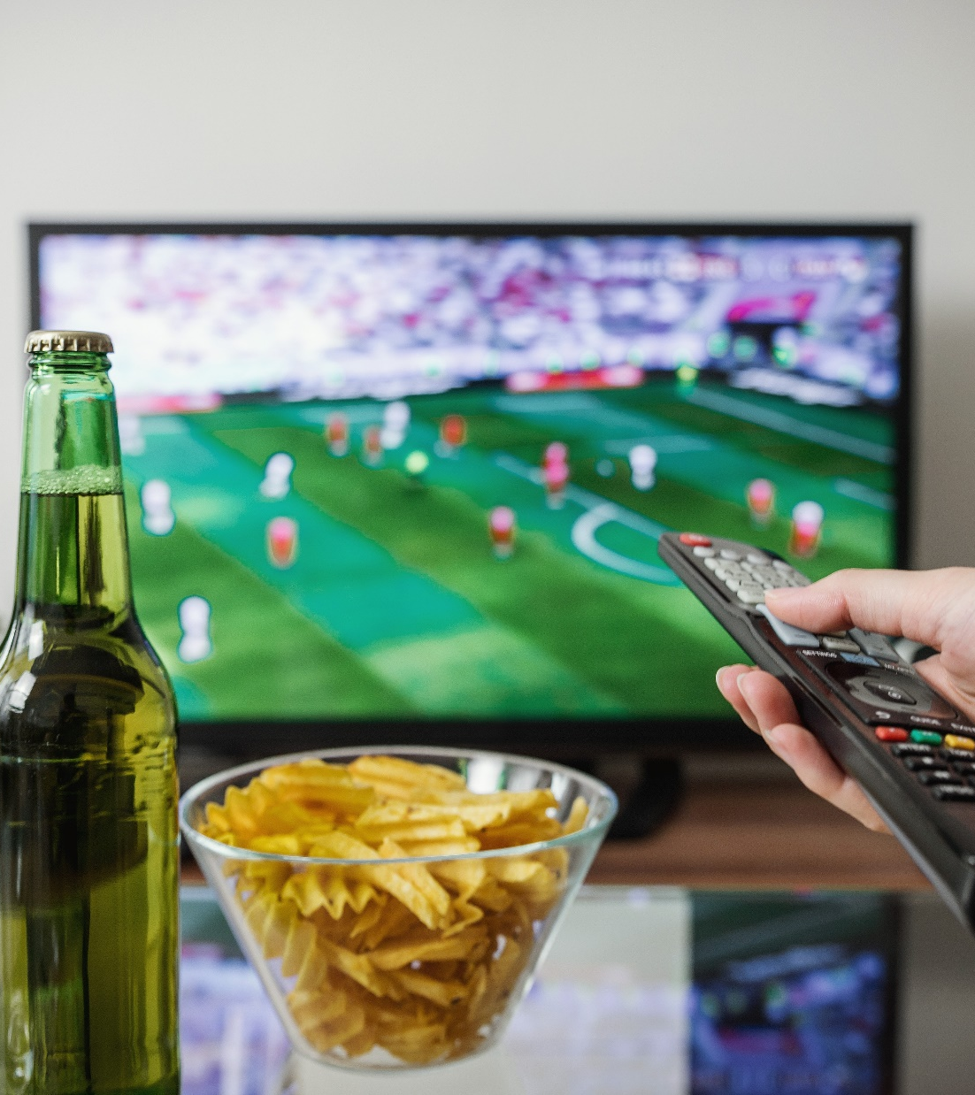
WATCHING SITUATIONS

Slide 17
Time of noted watching situations
In which part of the day did you watch the programme?
Almost half of recorded events fell into prime time (2 256 events). In the case of educated and employed respondents the predominance of evening watching is more significant.
For reliable segment size, “morning-afternoon-evening” merge categories will be applied.
N=4.733 | Base: all measured viewing situations

Slide 18
Average time spent on one programme
Approximately how long did you spend watching the programme?
56 mins
61 mins
51 mins
54 mins
58 mins
53 mins
AVERAGE
MALE
FEMALE
CHANNEL
PROGRAMME
OTHER
For one specific programme, the average admitted watching time was 56 minutes (the minimum was 15 minutes). Significance analysis shows considerably larger than average hours for men (61 minutes), over 40 years (59), those who watch movies and movie channels (68-69) and those who watch TV on the weekends. Same applies to those who sit down to watch a specific programme (58).
N=4.733 | Base: all measured viewing situations

Slide 19
Releative watching time
What percentage of the total programme did you watch?
No more than half of it 15%
43%
25%
17%
12%
3%
At least the half of it 85%
Watched the whole programme
Watched most of the programme
Watched more than half of the programme
Watched less than half of the programme
Barely seen any of the programme
Regardless the length of the programme, the vast majority of respondents watched at least half of the given programme. In 43% of cases respondents said to watch the whole programme. This ratio is outstanding within the over 50 group (50%), those who watch series (49%) who watch TV on the weekends (49%), who watch TV alone (49%) and who consciously choose the programme they watch (51%).
N=4.733 | Base: all measured viewing situations

Slide 20
Watched content
The main content you watched, belongs to which of the following categories?
Third of the recorded events were related to TV series, film comes after with one sixth of mentions. The category of documentaries, that usually is in the top 3 in studies done by self-declaration, only received 6% of the mentions.
33%
Series
17%
Movie
13% News programme
7%
Sport
6%
Documentary
6%
Quiz shows
5%
Reality shows
4%
Gastronomy
10%
Other
N=4.733 | Base: all measured viewing situations

Slide 21






Titles
Genre/categories– answers for the open ended questions, toplist
Sitcom
Series
Movie
Reality
News, reports
OP/LP
Agymenők
Family Guy
Modern család
Jóbarátok
Két pasi - meg egy kicsi
Így jártam anyátokkal
Csengetett Mylord
Barátok közt
A mi kis falunk
Jóban-rosszban
Dr. Csont
Szulejmán
NCIS
Columbo
Gyilkos elmék
Star Wars
Jurassik World / Park
Kincs ami nincs
Valami Amerika
Halálos iramban
Másnaposok
Jumanji
Meseautó
Nyerő páros
MasterChef VIP
Survivor
Sütimester
Híradó
Tények
Egyenes beszéd
Fókusz
Heti napló
Házon kívül
Nyerő páros
Barátok közt
Éjjel-nappal Budapest
Piramis
MasterChef VIP
A mi kis falunk
Jóban-rosszban
Showder Klub
There were significant mentions as well for: Bajnokok Ligája, Forma 1 nagydíj, Honfoglaló
N=4.733 | Base: all measured viewing situations

Slide 22
Social watching
Who were you watching this programme with?
48%
36%
12%
Alone
Partner
Child
6%
2%
1%
With company 52%
Alone 48%
Parent
Frinds, flatmates
Other
Respondents were admitted to watching TV alone in about 50% of the occasions while watching TV with company in the other 50%. The company is usually the watchers partner or child. Respondents over 50 (61%) and without children (54%) are more likely to watch TV alone.
N=4.733 | Base: all measured viewing situations

Slide 23
Social watching
Time of the day variable
The detailed daily breakdown shows a higher ratio of Social watching in access prime and prime time, while in the mornings in two thirds of the cases respondents watched TV alone.
N=4.733 | Base: total sample; N=2237 | Base: alone; N=2495 | Base: with company

Slide 24
Social watching
Content variable
According to the detailed genre classification animation, gastronomy and reality shows are typically socially watched. On the other hand, sport consumed at home is a genre that people usually watch alone.
N=4.733 | Base: total sample; N=2237 | Base: alone; N=2495 | Base: with company

Slide 25
Watched channels
As far as you can remember, on which channel was the programme broadcasted?
25%
RTL Klub
10%
TV2
6%
Comedy Central
5%
Film+
4%
M4 Sport
4%
Viasat3
3%
Cool
3%
Mozi+
3%
Super TV2
3%
M1
3%
Duna TV
2%
ATV
29%
Other
N=4.733 | Base: all measured viewing situations

Slide 26

AD ACCEPTANCE AND ALTERNATIVE SCREENS

Slide 27
Ratio of switching channels
How typical was it that you switched to a different channel, whilst watching a programme?
Switched channels during the progamme
Did not switch
Only during ads
Two out of three respondents claimed they did not switch channels during the programme, while in the rest they only switched during the adverts.
64%
32%
5%
N=4.733 | Base: all measured viewing situations

Slide 28
Switching channels during a programme
How typical was it that you switched to a different channel, whilst watching a programme?
total
>primary school
Primary school
High school graduation
university
● Did not switch
● Switched during ads
● Switched during a programme
By gender and age, there are no significant differences in switching habits. In the education breakdown, however there are some differences: those who never finished primary school are more likely to watch the whole programme with breaks (74%), and so are those with a university degree (66%).
N=4.733 | Base: all measured viewing situations
Notes:
A 18-49 éves nézők valamivel több, mint negyede nem nézte meg a műsort megszakító (vagy azt követő) reklámblokkot saját bevallása szerint. Ez az arány a fiatal nézőknél alacsonyabb (mint korábban megtudtuk elkapcsolás helyett háttértévézés jellemző). A férfiak a konkrét reklámblokkok tesztelése során szintén nagyobb türelmet tanúsítottak.

Slide 29
Switching channels during a programme
How typical was it that you switched to a different channel, whilst watching a programme?
total
Good financial situation
average
indigent
● Did not switch
● Switched during ads
● Switched during a programme
Subjective financial situation, similarly to the level of education and somewhat in connection with it, shows some differences in practice. Those who claim to have a good standard of living switch less than the average.
N=4.733 | Base: all measured viewing situations
Notes:
A 18-49 éves nézők valamivel több, mint negyede nem nézte meg a műsort megszakító (vagy azt követő) reklámblokkot saját bevallása szerint. Ez az arány a fiatal nézőknél alacsonyabb (mint korábban megtudtuk elkapcsolás helyett háttértévézés jellemző). A férfiak a konkrét reklámblokkok tesztelése során szintén nagyobb türelmet tanúsítottak.

Slide 30
Switching channels during a programme
How typical was it that you switched to a different channel, whilst watching a programme?
total
movie
series
other
● Did not switch
● Switched during ads
● Switched during a programme
In the case of genres, films give more motive to switch, if only for the length of them and the number of breaks (42% switches at least once).
N=4.733 | Base: all measured viewing situations
Notes:
A 18-49 éves nézők valamivel több, mint negyede nem nézte meg a műsort megszakító (vagy azt követő) reklámblokkot saját bevallása szerint. Ez az arány a fiatal nézőknél alacsonyabb (mint korábban megtudtuk elkapcsolás helyett háttértévézés jellemző). A férfiak a konkrét reklámblokkok tesztelése során szintén nagyobb türelmet tanúsítottak.

Slide 31
Switching channels during a programme
How typical was it that you switched to a different channel, whilst watching a programme?
total
RTL klub / tv2
entertainment
Movie channel
other
● Did not switch
● Switched during ads
● Switched during a programme
According to the significance analysis, switching ratios do not differ much neither in different parts of the day, nor in whether someone is watching alone or with company. The type of the channel however influences the switching. In connection to the previous conclusion, surfing is more typical on movie channels (only 54% does not switch), but specifically during adverts (40%).
N=4.733 | Base: all measured viewing situations
Notes:
A 18-49 éves nézők valamivel több, mint negyede nem nézte meg a műsort megszakító (vagy azt követő) reklámblokkot saját bevallása szerint. Ez az arány a fiatal nézőknél alacsonyabb (mint korábban megtudtuk elkapcsolás helyett háttértévézés jellemző). A férfiak a konkrét reklámblokkok tesztelése során szintén nagyobb türelmet tanúsítottak.

Slide 32

PARALEL ACTIVITES

Slide 33
Simulatneous screen usage
Did you use the following devices whilst watching the programme?
Neither
Smartphone
Laptop, notebook
computer
tablet
56%
34%
7%
5%
3%
Did not use any other screens 56%
Did use other screens 44%
The ratio of using alternative channels is 44%. For respondents under 30 (62%), living in cities (49-51%), in a good financial situation (48%) and those who watch less TV, this ratio is significantly higher. Amongst the different devices smartphone is the most popular: every third viewer used one while watching the programme. In the younger age group (55%) for those living with parents or flatmates (43%) and for female viewers (38%) this ratio is very high.
N=4.733 | Base: all measured viewing situations

Slide 34
Ratio of smart phone usage
Did you use your smart phone whilst watching the programme?
total | Gender | AGE | Financial situation
34%
male
female
30%
46%
Good financial situation
Average
indigent
38%
18-39
40-59
38%
27%
32%
32%
There are differences in smartphone use whilst watching TV, along the main demographic variables too. Intensive smart phone usage is most popular amongst the youngest age group.
N=4.733 | Base: all measured viewing situations
Notes:
A 18-49 éves nézők valamivel több, mint negyede nem nézte meg a műsort megszakító (vagy azt követő) reklámblokkot saját bevallása szerint. Ez az arány a fiatal nézőknél alacsonyabb (mint korábban megtudtuk elkapcsolás helyett háttértévézés jellemző). A férfiak a konkrét reklámblokkok tesztelése során szintén nagyobb türelmet tanúsítottak.

Slide 35
Ratio of smart phone usage
Did you use your smart phone whilst watching the programme?
total | Quality of attention | genre | Type of channel
34%
Watching tv in the background
Paying attentiion
41%
32%
Rtl Klub / tv2
entertainmnet
Movie channel
other
38%
movie
series
other
32%
35%
34%
34%
25%
For those who only watch TV in the background, the importance of smart phones is obvious, while in the genre breakdown there are no significant differences. The type of the channel is a factor in distinguishing between TV watching situations: those who watch “national channels” use their phones more than the average, while those who watch movie channels do not divide their attention as much.
34%
N=4.733 | Base: all measured viewing situations
Notes:
A 18-49 éves nézők valamivel több, mint negyede nem nézte meg a műsort megszakító (vagy azt követő) reklámblokkot saját bevallása szerint. Ez az arány a fiatal nézőknél alacsonyabb (mint korábban megtudtuk elkapcsolás helyett háttértévézés jellemző). A férfiak a konkrét reklámblokkok tesztelése során szintén nagyobb türelmet tanúsítottak.

Slide 36
Simultaneous activities
How did you use the device(s) whilst watching TV? When you were using the devices, which was your primary screen?
Only for a littlw while
Repetedly for a short time
longer but not during the wholw time
Continuously, whilst watching tv
39%
28%
18%
15%
Members of the parallel activity subsample, typically looked to the alternative screen for shorter periods. They were distracted by another device for longer in approximately one third of the cases.
63%
33%
3%
Mostly watched the TV, only looked at the phone screen a few times
Mostly watched the screen of the device and only listened to the TV
The primary activtiy was something esle, TV or other devices were only secondary
N=2.094 | Base: doing parallel activities

Slide 37
Relation to the programme
To what extent was the usege of the other device related to the programme watched on TV?
It was not realted to the programme at all, there was no instance
It was somehow related to the programme
It was related to the programme almost the whole time
Activities done parallelly cannot be called supplementary, it is rather substitute activity. It is rarely in connection with the watched programme (texting about it, visiting its Facebook site, reading about the actors in the film or voting on talent shows).
83%
14%
3%
N=2.094 | Base: doing parallel activities

Slide 38
Activities related to the programme
What was this activity?
49%
44%
38%
9%
Parallel activities in connection with the watched programme are usually browsing the internet, using social media or texting about the seen content.
Not many mentioned watching video content parallelly with other TV programmes. The subsample is suitability is limited, however it typically applies to males living in cities. Content wise, two out of three videos are short videos on social media platforms. In one third of the cases the watched content was a music video and in 1/6 is a sport event.
Browsing the internet
Social media activity
Messaging, chatting in an application
Phone calls,
video chat
9%
7%
7%
Watching video content
Voting (in text message or application)
Other
N=349 | Base: activities related to the programme

Slide 39
Reason behind the simultaneous activity
What was the reason of doing activities other than watching the TV?
59%
25%
Other activities were more important
The programme was not interesting enough, was bored
Most of the time the other activity was more important than the TV (phone call, had to answer an email). Every fourth respondent said the programme was not engaging enough, it was more common amongst those under 30 (31%), watching TV less regularly (30%) watching movies (30%) and those who did not consciously choose the channel (35%).
6%
3%
Did not care about the ad / was doing something else during the ad
Habit / watches TV like this / only have time for other things whilst watching TV
N=2.094 | Base: doing parallel activities

Slide 40
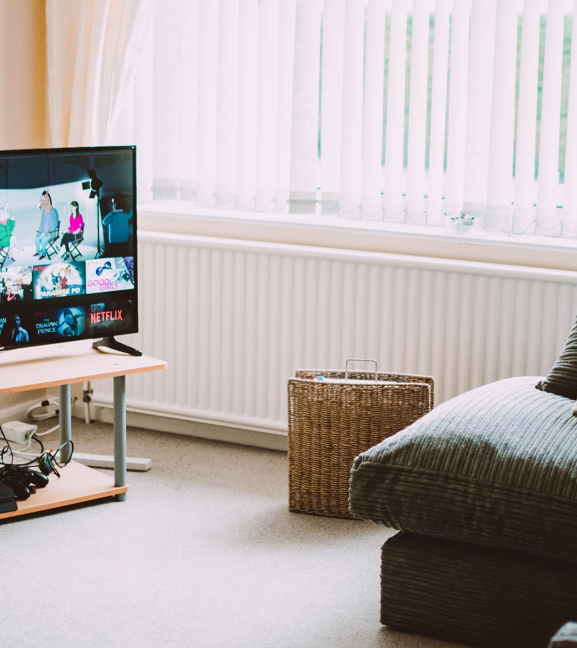
PRIMARY AND SECONDATY SCREENS

Slide 41
Primary screen
Whilst you were using the device, which screen did you concentrate on?
TV was the primary screen 63%
Other device was the primary screen 33%
For those who use alternative devices, out of three programmes for two the TV was more important and for one the other screen was the primary. This chapter will show different breakdowns to analyse the situations where the primary role of the TV is at risk in on the different demographic groups.
N=4.733 | Base: all measured viewing situations AND N=2.094| Base: using secondary device

Slide 42
Relationship between the primary screen and demographycs
Whilst you were using the device, which screen did you concentrate on?
male
female
18-39
40-59
85%
14%
81%
17%
80%
18%
87%
12%
On the basis of tv watchers
● TV is the primary screen
● Other device is the primary screen
On the basis of multiple screen users
67%
31%
60%
35%
62%
34%
65%
31%
The results show that females and the younger age group have a bigger affinity to give primary attention to the alternative screen.
N=4.733 | Base: all measured viewing situations AND N=2.094| Base: using secondary device

Slide 43
Relationship between the primary screen and demographycs
Whilst you were using the device, which screen did you concentrate on?
> Primary school
Primary school
High school diploma
University, college degree
86%
14%
87%
11%
83%
15%
80%
18%
On the basis of tv watchers
● TV is the primary screen
● Other device is the primary screen
On the basis of multiple screen users
73%
27%
67%
29%
64%
32%
59%
37%
Those with higher level of education are more open to alternative screens. When comparing types of settlement there are significant results only between Budapest and the countryside: those living in Budapest are more likely to have their attention diverted to an alternative screen, than the country average (59%-37% ratio on restricted base).
N=4.733 | Base: all measured viewing situations AND N=2.094| Base: using secondary device

Slide 44
Relationship between the primary screen and demographycs
Whilst you were using the device, which screen did you concentrate on?
Living with family
Living with parents/flatmates
Couple without children
Living alone
86%
13%
80%
20%
82%
16%
78%
20%
On the basis of tv watchers
● TV is the primary screen
● Other device is the primary screen
On the basis of multiple screen users
65%
31%
64%
35%
61%
34%
60%
39%
Households with kids typically more likely to put TV as first (65-31% ratio on the base of multiple screen users).
N=4.733 | Base: all measured viewing situations AND N=2.094| Base: using secondary device

Slide 45
Relationship between the primary screen and the watching situation
Whilst you were using the device, which screen did you concentrate on?
On the basis of tv watchers
On the basis of multiple screen users
● TV is the primary screen
● Other device is the primary screen
Beyond the parts of the day, in connection with it, it can be concluded that with company the dominance of TV is stronger, while when watching TV alone the relative dominance of the alternative screen gets stronger (although the differences are not significant).
N= varies by line| Base: using secondary device

Slide 46
Relationship between the primary screen and the content
Whilst you were using the device, which screen did you concentrate on?
On the basis of tv watchers
On the basis of multiple screen users
● TV is the primary screen
● Other device is the primary screen
TV screen losing its primary position is most common during animations but also considerable during quiz and reality shows as well as the news.
N= varies by line| Base: using secondary device

Slide 47
Relationship between the primary screen and the content
On the basis of tv watchers
On the basis of multiple screen users
● TV is the primary screen
● Other device is the primary screen
In connection with the genre, amongst the affected channels the three channels of “national tv” are in the bottom three of the list.
N= varies by line| Base: using secondary device

Slide 48
Relationship between the primary screen and the content
Whilst you were using the device, which screen did you concentrate on?
On the basis of tv watchers
On the basis of multiple screen users
● TV is the primary screen
● Other device is the primary screen
Sorting into channel categories also proves that movie channels require focused attention more, as well as that that the screen has the primary attention in their case.
N= varies by line| Base: using secondary device

Slide 49
Relationship between the primary screen and the motivation
Whilst you were using the device, which screen did you concentrate on?
On the basis of tv watchers
On the basis of multiple screen users
● TV is the primary screen
● Other device is the primary screen
Concentration of attention, frequency of parallel screen usage and the relative weight of TV show high covariance.
N= varies by line| Base: using secondary device

Slide 50
Relationship between the primary screen and the motivation
Whilst you were using the device, which screen did you concentrate on?
On the basis of tv watchers
On the basis of multiple screen users
● TV is the primary screen
● Other device is the primary screen
As expected, conscious content choice results in a more concentrated attention on TV screens.
N= varies by line| Base: using secondary device

Slide 51
SECONDARY ROLE OF TV

Slide 52
Target group affinitive to alternative screens
Demographic description
Whole SAMPLE
TV secondary
● 18-29
● 30-39
● 40-49
● 50-59
Amongst those whom tv (sometimes) gets put in secondary position, there are significantly more the under 30 years old, females, city residents and university degree owners.
N=1.642 | Base: 18-59 population, who watch TV AND N=266 | Base: primarily using another device

Slide 53
Target group affinitive to alternative screens
Attitude
In harmony with the studied events, these viewers use TV more as a background stimulus on a daily basis (48% compared to the 33% on total sample).
N=1.642 | Base: 18-59 population, who watch TV AND N=266 | Base: primarily using another device

Slide 54
Conaumption on alternative screen
Time of the day, Genre
All TV watching situations
TV watchig situations where the tv is secondary
● Mornign
● Afternoon
● Evening
● RTL Klub/TV2
● Movie channel
● Entertainment
● Other
Secondary position of TV appears in significantly smaller ratio in the case of long-tail channel consumption, while there is no measurable direct correlation on the level of parts of the day.
N=4.733 | Base: all measured viewing situations AND N=729 | Base: primarily using another device

Slide 55
Consumption on alternative screen
Content
● Series (30 minutes long episodes)
● Movie
● Series (1 hour long episodes)
● News
● Quiz show
● Reality show
● Sport
● Animation
● Factual
● Gastronomy
● Other
All TV watching situations
TV watchig situations where the tv is secondary
At those events, where TV is only secondary, the ratio of consuming 30 minutes long series is higher, with this it is the most popular genre (on the total sample it is the third).
N=4.733 | Base: all measured viewing situations AND N=729 | Base: primarily using another device

Slide 56

SUMMARY

Slide 57
Conclusions
The 5Ws methodology gives a more legitimate picture about the viewing situations than the classic questionnaire research. The robust sample made it possible to examine the demographics and contextual relationships in depth.
Alternative screens usually divert the viewers’ attention for a second. The alternative screen was primary in one third of the cases, while it was exclusive in one sixth of them.
The target groups that put TV at a risk of losing its primary position are the educated segment, while there are no demographic group where the alternative screen is at risk.
Situations with at least 15 minutes viewing time, approximately third of the audience switches during the break.
The parallel screen usage is measurably present in the viewers daily life, respondents use multiple screens in about half of the viewing situations. The device is a smart phone most of the time and its usage is not connected to the watched programme.
In the case of genres animation is the only one that could become suitable for smaller screens as smart devices spread. From all the channels the three with the biggest coverage: M1, TV2 and RTL Klub are the most risk.
Fragmentation of attention comes with the usage of alternative screens. The consciously chosen and hence important content for the viewer decreases the possibility of using other devices or loosing attention. Typically, viewer retentive contents are movies, music entertainment programmes, talent shows and commercial hour series, while on the other end, there are the animation, quiz shows and the news. We can talk about quality consumption in the case of movie channels (despite the high ratio of switching during breaks).

Slide 58

CONTACT AND REFERENCE

Slide 59


Balázs is a marketing expert having unique experience in field of media (especially TV) research and consultancy. He started his career at a market research company BellResearch in 2006. From 2008 he gained experience as research manager of Viasat Hungary. As head of innovation he worked for market leader media agency Omnicom Media Group between 2014-2015, while he also participated in ad-hoc projects at Viacom and Synetiq. Balázs joined Ipsos in 2015 in the position of Media Team leader.
Balázs Kovács
Media Research Director
Balazs.Kovacs@ipsos.com
Tel: + 36 70 330 7188
Dr. Nikolett Geszler
Senior Research Executive Nikolett.Geszler@ipsos.com
Tel: + 36 30 836 3589
Nikolett is an experienced sociologist, who achieved a PhD status in 2016. She gained several years of experience in academic research and teaching. Currently she is a member of a research group about children, ICT and work-life balance. She has presented her findings at national and international conferences, as well as published in scientific journals. She joined Media Team of Ipsos in 2015 and reached senior research executive status in 2017.
Pap Károly utca 4-6, 1139 XIII. kerület, Budapest

Slide 60
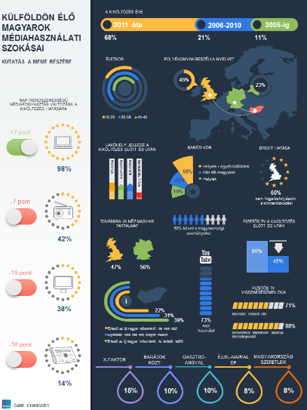
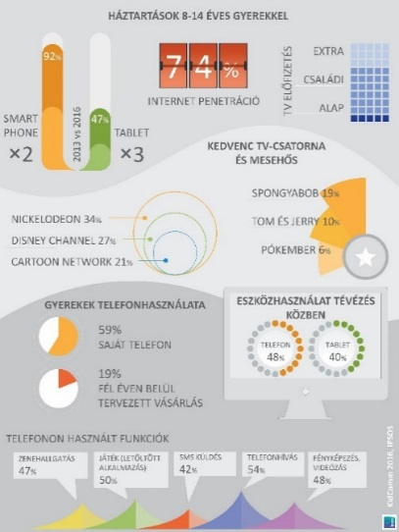
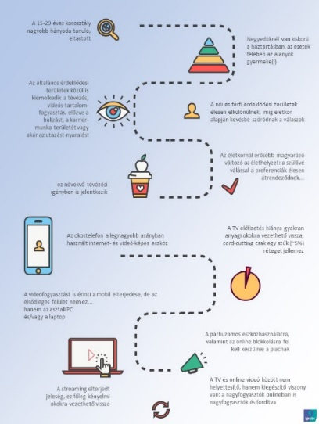
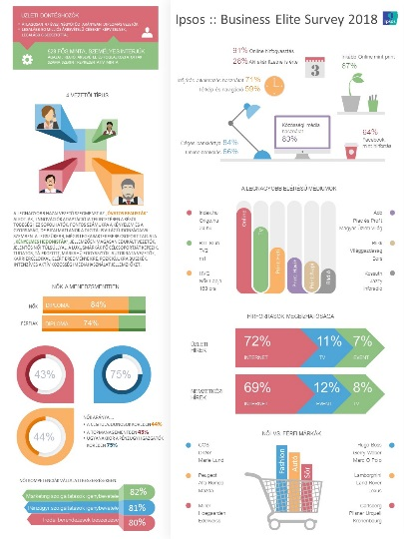
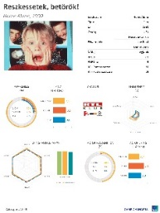
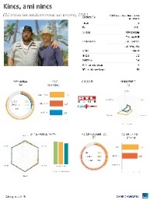
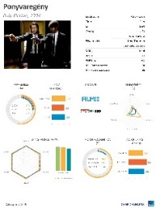
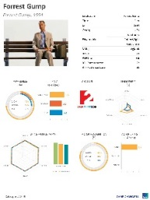















Media industry studies in the care of Ipsos
MEME Expat Research 2016
KidComm Survey 2016
TV Acquisition Survey 2016
MEME Youth Research 2017
Business Elite Survey 2018
Our partners in syndicated research:

Slide 61











































































































Ipsos Hungary References – 2010-2018

