Slide 1

TV Content Consumption Habits in Hungary
A Study Carried out for MEME
GfK Hungária, November 2015

Slide 2
Agenda
1. | Summary | Main conclusions of the research
2. | Methodology | Short overview of research background and selected methodology.
3. | Main results of the study | Main results of the qualitative and quantitative phase of the research. Basic content selection habits, segmentation of respondents based on these habits, main characteristics of the segments.
4. | Detailed results of the qualitative phase | Main results of qualitative phase (observation) about content consumption habits of defined segments.
5. | Detailed results of the quantitative phase | Main characteristics of defined segments based on the quantitative research phase (online questionnaire) by demography, possession of devices and services, watched contents and attitudes.

Slide 3
Summary

Slide 4
Summary – I.
TV content selecting habits in 2015
According to the research conducted in autumn 2015 (average Wednesday evening between 17:00 and 23:00), only 1% of all the selected programs, watched by 18-69 years old respondents having a TV, was non-linear content. This means that 99% of all the watched programs was linear, and 90% of these linear contents was watched on any of the channels with generally having the highest ratings (RTL Klub, TV2, Cool, Viasat3, Film+, M1, M4 Sport).
69% of the watched programs were selected consciously, respondents pre-decided to watch them mainly because or program preference. Those programs, which were not pre-decided to be watched, were found mainly by surfing (83%). In these cases, decisions were based on program preference, channel preference or because respondents found them interesting. Generally, in content selection brand equity of programs and channels play an important role, most of the viewers have a clear preference concerning TV programs or TV channels.
Based on the decision mechanism and patterns (co-viewing, time of the decision, program preferences), the research could identify three segments: alone, conscious TV viewers (35%), in a company, conscious TV viewers (38%), and switchers (27%). (Under conscious we mean, that respondents have already decided what content to watch before turning on the TV.) Besides these segments we could sense a linear – non-linear dimension as well, but non-linear content consumption is such a small part of total TV-viewing time, which could not make it possible to have numeric conclusions. However, in the qualitative phase we have visited two households, who have watched at least one non-linear contact on the analyses daypart.

Slide 5
Summary – II.
Segments based on decision making mechanism – I.
  Alone, conscious TV viewers (35%): TV plays a central role is spending their leisure time (friend). These people know, what they will watch, before turning on the TV. They have favorite programs, which they try to follow continuously. Current program supply is mostly satisfying for them, they can select those programs from it, which they can watch day by day. They get involved in the given program and mostly stay on the channel during the ad brake.
  In a company, conscious TV viewers (38%): mostly watch TV programs with their family as a collective relaxation. TV play an important role in spending their spare-time (friend), but not recline only upon it. They also pre-decide what to watch on TV, they have strong program preference and find current program supply more or less satisfying. They take into consideration more factors when deciding what to watch, as they try to find content which is good for all the family members. Generally they don’t stay on ad brakes, they go out of the room or switch off the channel. Non-linear content consumption is an emerging trend in this segment: if they can’t find a content which would be preferred by all the family members, they turn to non-linear contents.
  For those, who watch content also in non-linear way, TV is only a device where the program can be presented, only some of the TV programs can provide „the feeling of alive show” e.g. sport events. Their aim is to maximally utilize their time, in which longer ad brakes can not be fitted, so all the time, if they can, they skip ad brakes.

Slide 6
Summary– III.
Segments based on decision making mechanism – II.
  Switchers (27%): they are the critical content consumers, TV does not play an important role in spending the spare-time (acquaintance). They would like to maximally utilize their spare-time, so they select a program because of its content. They are very critical with current TV program supply, they select the programs mainly by surfing the channels (they decide in ~10 seconds if the program is interesting for them or not). Switchers rather have channel preference, they start surfing first on those channels, where they can generally find relevant content the most often. They skip the ad brakes by switching off the channel (conscious ad avoiders) and more likely tend to watch recorded programs than the average.
  Channel and program preference: the conscious segments are more likely watch channels with generally higher ratings (families selected significantly more programs on RTL Klub, who aims broader target audience), while Switchers have chosen more contents on thematic channels. The most popular program type was series, which could be lead back to the fact that these programs starts in a fixed time on a fix channel, which makes is easier to plan with these programs in the daily routine. On the other hand it is easier to get involved in them for a longer time period. Also news is a popular program type, while all the 7th programs selected by switchers were movies/films.

Slide 7
Methodology

Slide 8
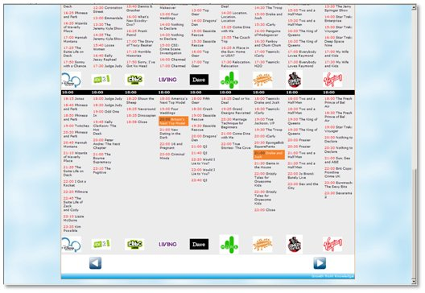
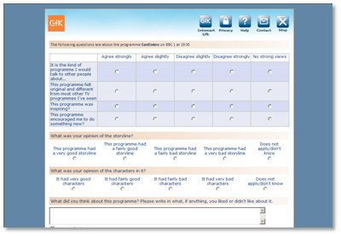
Quantitative phase (online questionnaire)
Methodology
  Respondents were pre-recruited and informed about the time they will need to fill in a questionnaire (as all the respondents had to tell us what they have selected from the fix program-structure of the given evening)
Respondents, who took part in this research, could start to fill in this special questionnaire in the given evening (after 23:00) or on the next morning
2. In the fist part of the questionnaire they had to select from the scripted program structure what they have watched on the given evening.
3. In the second part of the questionnaire they had to answer some questions related to the selected programs (e.g. if they planned to watch the given program, how did they decided to watch it etc.), and also some general questions were asked.

Slide 9

A kérdőíves kutatás módszertani háttere
Methodology
Target audience
Sample
Timing
Online, self-filled questionnaire (CAWI), filled by respondents registered in GfK’s online panel
Sample:
Representative sample to 18-69 years old population by gender, age, and settlement type
Screening criteria:
  18-69 years old
  Have at least one TV device in the household
  Have been watching TV (any content, TV program, film, series or anything else on the given day between 17:00 and 23:00
  Have selected at least one content in the diary (scripted program-structure)
Weighted sample size:
n=658 respondents (planned sample size: 400)
n=2181 programs (planned number of programs to analyse: 1600 )
Day of questioning:
08.10.2015.
Date and dayparts of watched and so analysed programs: 07.10.2015.
17:00-23:00
20
80
1

Slide 10
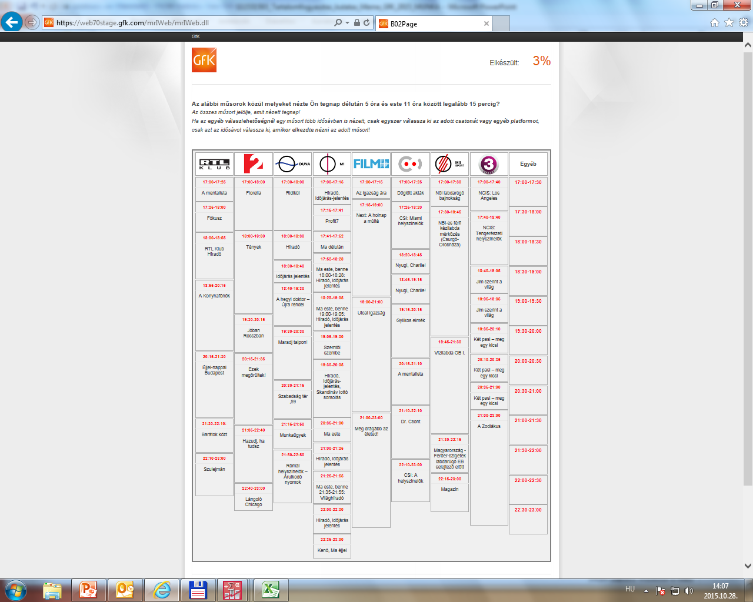
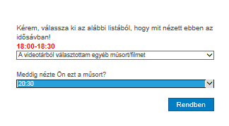
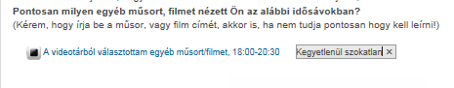
Research background of quantitative phase – the diary
The diary, which is an own development of GfK, adopted to this specific research
20
80
1

Slide 11
Main differences between the diary and official audience measurement
Diary
Audience Measurement
Respondents origin, frequency of measurement
One shot, respondent are coming from GfK online access panel, where they registered to fill in online questionnaires
We asked the respondents to remember, what they have watched yesterday, and asked them to sign it in a diary showing them the program-structure in a grid. With using this methodology we have to rely on respondents’ memories, but with „yesterday” methodology it is possible to decrease the amount of lost information because of memory loss.
In current research sample size was: 658 respondents. We analyzed TV viewing habits on an average day in prime-time (17:00-23:00), with asking for only the programs having watched for at least 15 minutes.
In ad-hoc research it is possible to ask questions about other topics, not only TV viewing, so we could un-cover mechanism behind program selection, could also analyse main attitudes of respondents and the role of TV device and TV content in their leisure time and life.
Continuous measurement, respondents are members of the audience panel, which was specially set up to measure TV viewing
In audience measurement generally the programs running on TV is recorded with the help of a device (set-top-box) and the only information asked is, who watch the TV in that moment. The error coming from not using the remote control or not watching the given program, is handled with different methodologies (e.g. reminder questions).
Sample size is generally higher (1000+) and based on households. All the content presented on the TV screen is measured from minute to minutes every day.
With using data coming from audience measurement it is possible to analyse number of contacts, reach, time spent on channels, programs or ads, but is does not make it possible to analyse mechanism behind the program selections, respondents attitudes toward TV content or the role of it in everyday life.
Methodology of measurement
20
Sample size, analysing possibilities
80
1

Slide 12
Research background of ethnographic interviews
Methodology
  We have pre-recruited the participants to let the researcher in their home and let her spend in the household a whole evening. 12 participants were selected based on their answers given in the quantitative phase, they were typical members of the defined segments based on the content consumption habits)
1. Participants and the moderator met before the participant typically start his/her evening program. In the first 10-15 minutes the researcher told the participant to do things in the same way as usual, don’t change anything in his/her behavior , don’t feel embarrassed.
2. During the observation the researcher took notes about the participants behavior: when, what did he watch, how did he find the given program, were the household members talking between the programs, who decided what to watch etc., but she did not interrupted them, asked them or intervened, she let them do what they usually do.
3.At the end of the observation the moderator asked her questions to be sure, that she could understand the main motivations behind the given activities or to have answers for those questions, which can’t be answered by purely watching the activity and the environment (e.g. who recommended to watch the given program, which programs they generally watch, which programs do they choose automatically etc.)

Slide 13


Methodology background of ethnographic interviews
Methodology
Target Audience
Sample
Timing
12 ethnographic interviews12
Active observation of TV watching habits in the home of the participant
Male and Female
18-60 years old
TV viewers, who took part in the quantitative phase as well
Selecting the participants was based on their response in the qualitative phase (we have contacted typical members of the defined segments)
n | Attributes of the groups
1 | Alone, conscious TV viewers: 4 participants
2 | Switchers: 4 participants
3 | In a company, conscious TV viewer : 4 participants 2 participants, who watched non-linear contents 2 participants, who watched linear contents
19th October
– 2nd November 2015

Slide 14
Main results of the study

Slide 15
STILL LINEAR - 90:10 TOP 8 CHANNELS
Watched content: linear way (99%), on channels with highest rating (90%)
Linear / non-linear
Channels
1%
90%
Base: all watched programs, n= 2.181
Base: all watched programs, n= 2.181
Non-linear contents
Only 1% of all the watched programs were consumed non-linearly (film or program stored on CD/ DVD / pen drive, saved from TV, selected from video store or streamed).
Content watched on channels with highest rating
90% of all the selected programs was watched on any of the 8 most often watched channels. Favorite content on these channels was series, 48% of all programs watched on these channels were series (19% news, weather forecast, 6% movie, 17% other)
B02. Which of the following contents have you seen yesterday from 17:00 to 23:00 for at least 15 minutes?

Slide 16
(ALSO) OWN DECISION, FOR CONSCIOUS CONSIDERATION
Talent Market Germany
Watched programs: at 69% respondents pre-decided to watch them
Number of viewers (alone, in a company)
Programs having been watched alone: 42%
Programs having been watched in a company: 58%
Participation
Respondent participated in decision: 96%
Respondents did not participated in decision: 4%
Time of decision
(base: who participated in the decision)
Respondent pre-decided to watch: 69%
Respondent did not pre-decided to watch: 31%
58%
96%
69%
Base: all watched programs, n= 2.181
Base: all watched programs, n= 2.181
Base: all watched programs, where the respondent took part in the decision, n= 2.099
More than half of the watched programs were watched by more people in the household
Watching the selected content is not a must. Respondents took part in deciding what to watch at almost all the selected programs, or the respondent /made the decision.
2/3 of selections were pre-decided, which means that respondents decided before the programs have started that they watch the given content, so they made a conscious decision.
B04A, How many people in your household have watched the selected program? If more people have watched, who decided?
B04B. Have you pre-decided to watch this program?

Slide 17
PROGRAM PREFERENCE AND SURFING
Higher proportion of selected programs was pre-decided, mainly based on program preference or routine, smaller proportion was selected by surfing (based on program preference or interest)
PRE-DECIDED PROGRAMS (69%)
NOT PRE-DECIDED PROGRAMS (31%)
ALL, THERE WAS NO BETTER
FAVORITE, PREFERENCE
93%
83%
PREFERENCE
ALL, INETEREST
ALL, PREFERENCE
FAVORITE, INTERESTED
LOYALTY
FAVORITE, THERE WAS NO BETTER
Base: pre-decided programs, n= 1.441
Base: not pre-decided, linear programs, n= 648
Pre-decided programs
93% of pre-decided programs were contents, which are watched by the repondents regularly or from time to time.
Role of program magazines, trailers or offers is minimal in decision making process. This could be, because there were not really new programs in the analyzed time-interval, and in case of generally or from time to time watched programs the starting time is already known.
Not pre-decided programs
83% of not pre-defined programs was found via surfing. 64% of this programs was selected by surfing on the favorite channels, 28% of them was already known by the respondents as they watch them from time to time. At 42% the respondent has selected the given content based on what they had already seem from it. 13% of programs were watched because respondents could no find any better one during the surfing.
B04C. Based on what have you decided to watch this program?
B04D. How did you decide to watch this program?

Slide 18
TIME OF THE DECISION AND PREFERENCE
Supposed decision tree (before the research), based on the result of the quantitative research phase
Respondent took part in deciding what to watch
(96,3% of programs)
Pre-decided programs (66,1% of programs)
Form this not linear: 1,2%
Always watched
(41,7% of programs)
From time to time watched
(19,7% of contents)
Other
(4,7% of contents)
Was surfing, stayed here (16,4% of programs)
Not pre-decided programs
(30,2% of programs)
Was surfing, generally watch it (8,3% of programs)
Stayed here after the ad brake
(2,2% of programs)
Background noise, other
(2,8% of programs)
Non-linear programs (0,5% of programs)

Slide 19
MAIN INFLUENCING FACTORS
Defining segments based on program selecting habits
NUMBER OF VIEWERS
TIME OF DECISION
Alone
In a company
Pre-decided
Found by surfing
PROGRAM PREFERENCE
Favorite programs
Liked programs
Factors involved in creating the segments: Share of programs watched alone/ Share of pre-decided programs / Share of pre-decided, always watched programs / Share of pre-decided, from time to time watched programs / Share of not pre-decided programs found by surfing / Share of not pre-decided programs, found by surfing on favorite channels / Share of not pre-decided programs found by surfing on all channels / Share of not pre-decided programs, found by surfing, generally watched by the respondent / Share of not pre-decided programs found by surfing and was interesting for the respondent / Share of not pre-decided programs found by surfing on which the respondent stayed

Slide 20


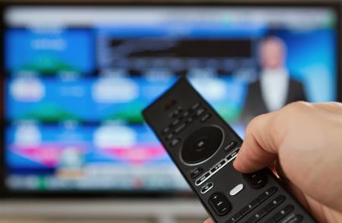
SEGMENTS BASED ON PROGRAM SELECTING HABITS
Segments based on content selecting patterns, created by using statistical methodology
35%
38%
27%
Alone, conscious TV viewers
In a company, conscious TV viewers
Switchers
  They typically watch the TV alone, and know what they will watch before turning on the TV
  Surfing between the channels is not so typical activity for them
  They typically watch the TV in a company (more people from the household) and more likely pre-decide what content to watch than the average
  Surfing between the channels is not so typical activity for them
  Typically they don’t know what to watch before turning on the TV
  Generally they select the content to watch by surfing the channels

Slide 21
THE MAIN CHARACTERISTICS OF SEGMENTS – QUALITATIVE PHASE
Alone, conscious TV viewer
In a company, conscious TV viewer
(LINEAR)
Switcher
TV: part of everyday life, FRIEND
aim: RELAXING
PROGRAM-oriented choice
TV guide is known BY HEART
Current offering is SATISFYING, have favourite programs
DO NOT SWITCH, they are involved
NOT SOPHISTICATED device usage
WATCH ads
TV: part of everyday life, FRIEND
aim: RELAXING together
PROGRAM-oriented choice
TV guide is known BY HEART
Current offering is MOSTLY SATISFYING
MOSTLY DO NOT SWITCH, they are involved
BASIC device usage
SWITCH in case of ads
TV: ACQUAINTANCE
aim: fill the free time with USEFUL THINGS
CONTENT-oriented choice
DECIDE AT SWITCHING, during 10 sec.
CRITICAL of current offering, select
SWITCH, if the content is not appropriate, involved
HIGHER LEVEL device usage
AVOID ADS

Slide 22
DECISION TREE - Alone, conscious TV viewer
QUALITATIVE PHASE
Alone, conscious TV viewer
Dominate the decision making process or they decide ALL alone
EVENING NEWS– watch preferred channel, typically watching the whole program
18-21 h
Stay at the selected channel and watch the next program
SWITCH TO another channel where preferred, liked program starts soon: political talk show, quiz, series.
Stay at the selected channel and watch the next program
SURFING – the main purpose is to find interesting, meaningful program. They watch a movie ONLY from the beginning to the end.
PRE-PLANNED (port.hu) evening movie, series
Getting ready for bed BACKGROUND TV NOISE
PRE-SELECTED thematic programs

Slide 23
DECISION TREE - In a company, conscious TV viewer, LINEAR
QUALITATIVE PHASE
Decision making process types: 1) Once you, once me. 2) compromise: everyone resigns their desire and choose a third, intermediate content, 3) win-win: everyone feels that the selected content is the winner one.
In a company, conscious TV viewer, LINEAR
FAMILY, start TV watching in the early evening (5-6 pm), especially relevant content for kids are preferred (kid channels, M2, Minimax)
COUPLES start with favourite series, they know exactly when and where they begin.
During dinner, bath time BACKGROUND TV NOISE is characteristic or they watch their favourite program
SWITCH TO another channel where starts another favourite serie. They watch series, they change ONLY the channels .
After kids went to sleep series, quiz for adult are prefrred.
Look for FAMILIAR CONTENT consciously There is no favourite channel, JUST favourite show.

Slide 24
DECISION TREE - Switcher
QUALITATIVE PHASE
Switcher
Whoever holding the remote control, it has „the power”
Interest driven channel selection
FIXED EVEING PROGRAM.(e.g. News, Konyhafőnök, Bones)
If THE CONTENT IS APPROPRIATE watch while it is interesting, meaningful.
If the content is not appropriate then SURFING
Families record the political programs, news and they rewind them and watch after kids went to sleep .
After interesting programs, SURFING only between relevant channels.
In case of advertising block they switch to another channel immediately and SURFING. If they find more interesing program, stuck there. If not, surfing until the end of advert block.
Channel menu is kept in mind primarily, those channels are visited where they find relevant content earlier.
Because of advert block, they RECORD or watch later the favourite programs. In an evening they watch 1-2 programs typically.

Slide 25
ALONE, CONSCIOUS TV VIEWERS
Typical characteristics of the segment, which differ from the average
FEMALE(58%, Index: 114)
OLDER(50+: 51%, Index: 138)
LOWER SUBJECTIVE ECONOMIC STATUS (38%, Index: 131)
SINGLE, DIVORCED (49%, Index: 153)
HOUSEHOLD SIZE: 1 (21%, Index: 175)
FEWER SMARTPHONE THAN THE AVERAGE (1 db: 39%, Index: 130)
TYPICALLY WATCHED ALONE THE SELECTED PROGRAMS (97%, Index: 176)
PRE-DECIDED TO WATCH THE SELECTED PROGRAMS (84%, Index: 1727)
HAVE FAVORITE PROGRAMS, WATCHING TV IS A HABIT
TV PLAYS A CENTRAL ROLE IN LEISURE TIME

Slide 26
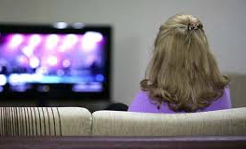

ALONE, CONSCIOUS TV VIEWERS
The TV presents organically in their life. DAILY, EASY ENTERTAINMENT feelings attached to it. They have well developed daily routine, the schedule of favourite programs are kept in mind, they watch the programs from the beginning to the end, surfing is less typical. If they choose a relevant content which is appropriate they follow the program faithfully.
The TV is a DAILY PARTNER, FRIEND. IT HAS CENTRAL ROLE IN THE EVENING ENTERTAINMENT. They know the program offer comprehensively, they watch the programs one after another. They adjust their life to the TV. BUT those who have experienced the advantages of recording, the personalization as demand has been created. The selection of the segment is typically PROGRAM-DRIVEN, based on personal taste. They are involved in particular programs.
DEVICE USAGE IS NOT SOPHISTICATED, they own LCD TV mostly. The TV watching closely tied to the TV, consuming content on other device is rare. The segment slightly turned to the on-demand media services, BUT an attractive program, missed news navigate them to this platform.
Advert consumption is minimal, BUT they mostly stay at selected channel while advert block lasts.

Slide 27
IN A COMPANY, CONSCIOUS TV VIEWERS
Typical characteristics of the segment, which differ from the average
MARRIED, LIVES IN PARTNERSHIP (82%, Index: 122)
INACTIVE(48%, Index: 114)
HIGHER HOUSEHOLD SIZE, AT LEAST ONE CHILD IN THE HOUSEHOLD (3 or more people: 67%, Index: 118, at least one child: 35%, Index: 125)
MORE SMARTPHONES, TABLETS THAN THE AVERAGE (2 or more : 62%, Index: 111)
TYPICALLY THE SELECTED PROGRAMS WERE WATCHED BY MORE PEOPLE (alone: 13%, Index: 24)
THEY PRE-DECIDED TO WATCH THE SELECTED PROGRAMS (82%, Index: 124)
TV DOES NOT PLAY A CENTRAL ROLE IN LEISURE TIME, BUT IT IS NOT ONLY BACKGROUND NOISEA TV

Slide 28
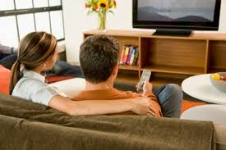
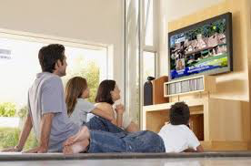
IN A COMPANY, CONSCIOUS TV VIEWERS
Their behavior, thinking are similar in many cases with the alone, conscious TV viewers: THE TV WATCHING IS MOSTLY PLANNED, BUT FAMILY PROGRAM SCHEDULE exists in their mind. The TV watching is closely connected to the COMMON ENTERTAINMENT.
The TV is a DAILY COMPANION for this segment, too. It has key role in the family entertainment. BUT TV viewing is strongly connected to joint decision-making, the segment seeks the common experience of entertainment. The segment is broadly aware of program schedule and which of these are suitable for everyone. They select from defined program set, switching is not typical. They switch to another channel when no relevant content is available to any family member. PROGRAMS OF BROAD TARGET AND AGE GROUP COULD EASILY REACH THE SEGMENT. Their decision making process is mostly family and program driven.
The DEVICE USAGE of the segment is mostly BASIC, they are typically linear TV viewers. The set-top-box is mostly used for orientation. Downloading movies is mostly considered at weekends as family cinema. At that time they connect laptop to the TV because screen experience, quality is quite important during consumption. Catch-up TV, VOD services are not used, since only one person would be interested in the family. However, we met a family where the eldest child used on-demand media services quite frequently – mostly Catch-up TV, downloaded contents - independently of other family members.
In case of ADVERTISING BLOCK they switch to another channel immediately: for families this period offers chance to do home tasks, for couples the advertising block breaks the intimate atmosphere of favorite series, programs.

Slide 29
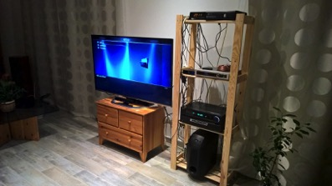
IN A COMPANY, NON-LINEAR, CONSCIOUS TV VIEWERS
In terms of TV watching habits it is still a unique, small segment. THEY HAVE DAILY CONTACT ONLY WITH TV SCREEN, LINEAR PROGRAM CONSUMPTION IS NOT TYPICAL.
THE TV HAS FUNCTIONAL ROLE in their life, they watch the downloaded contents through TV. Therefore they describe TV watching as content consumption which is associated with personalized entertainment. Regardless the week period, mostly EVENING consumption is characteristic. At this time they mostly watch episodes of followed series or movies. One program type is able to REACH non-linear segment: SPORT PROGRAMS (football, Formula-1). These programs attract people in LIVE, following events have top priority.
Offerings of personal server or torrent page are checked mostly, after choosing an appropriate content they watch the content together. THEIR SELECTIONS ARE MOSTLY IMPULSIVE, EXCEPT FOR THE LATEST EPISODE OF THE FAVOURITE SERIES. The latter one is followed and downloaded after airing.
The segment follows the novelties of TELECOMMUNICATION, COMPUTER DEVICES. Accordingly they built a consciously structured device park which maximally serve home entertainment. The main target is the uninterrupted home entertainment, content consumption.
Considering US series, movies the segment is up-to-date, they read about series summaries and follow the new seasons of favourite series. Because of their language skills, English content consumption do not cause any difficulties.

Slide 30
SWITCHERS
Typical characteristics of the segment, which differ from the average
MALE (54%, Index: 110)
MIDDLE-AGED (30-49 y.o.:52%, Index: 121)
HIGHER SUBJECTIVE ECONOMIC STATUS (31%, Index: 120)
HIGHER ECONOMIC ACTIVITY (31%, Index: 120)
MORE TV, SMARTPHONES, CABLE-TV, TSV AND VOD SERVICE
LIVES IN PARTNERSHIP, BUT NOT MARRIED (26%, Index: 118)
FIND CONTENTS BY SURFING THE CHANNELS (74%, Index: 308)
DO NOT STICK TO CONCRETE PROGRAMS
TV PLAY A SUPPLEMENTARY ROLE IN LEISURE TIME

Slide 31
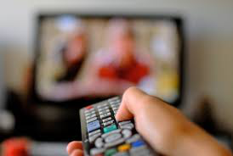
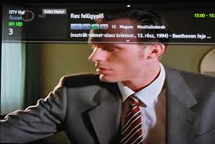
SWITCHERS
The switcher segment is more IMPULSIVE, exclusively THE CONTENT defines their selection. TV viewing equals with QUALITY CONTENT SEARCHING. They decide about the content FAST AND CRITICALLY, one program has maximum 10 seconds to convince them. Superficial background TV noise is not characteristic among them. If they choose a content which meets their expectations and intellectual needs they watch it from the beginning till the end. Switchers with family follow each other in the front of TV, only family movies could gather them to the TV.
They watch TV mostly in EVENING. Due to the lack of time, they watch 1-2 programs per evening. Therefore they would spend their spare time with useful things. They frequently record programs to avoid advertising blocks and shorten the programs. Customizing the programs has great importance for this segment.
Despite the fact they have daily contact with the TV, they consider it rather acquaintance. The TV has no essential role in their life, they satisfy their needs for entertainment in other channels (music, book). As the source of distancing, they less identify with the current program offerings. Moreover they find FEW PROGRAMS being valuable for them. In addition, they have difficulties with monotonous, one-sided content.
SET-TOP-BOX dominates their device usage, they use its functions as stopping, recording and rewind frequently. The main target is the CONTENT CONSUMPTION. Moreover by the help of the information line they review offerings quickly, it has key role in their decision making process.
Usage of on demand services is less characteristic. Catch-up TV services come to foreground when something interesting news are missed.
Advert blocks fairly interrupt content consumption, therefore the segment CONSCIOUSLY AVOID ADVERTS.

Slide 32
THE RELATIONSHIP OF OFFERS AND DEVICE USAGE - QUALITATIVE PHASE
Current offering insufficient
In a company, conscious TV viewers, non-linear
Switchers
NO device usage
Active device usage
In a company, conscious TV viewers, Linear
Alone, conscious TV viewers
Current offering sufficient

Slide 33
THE RELATIONSHIP OF PROGRAM AND CONTENT – QUALITATIVE PHASE
Alone, conscious TV viewers
Program driven
In a company, conscious TV viewers, Linear
TV has functional role
TV is a close friend
Switchers
In a company, conscious TV viewers, NON-linear
Content driven

Slide 34
Detailed results of the qualitative phase

Slide 35
TV viewing: Spontaneous Reactions
Alone, conscious TV viewer
In a company, conscious TV viewer (LINEAR)
Switcher
Fun, entertainment, regular program, relaxation
= EVERYDAY RELAXATION
Relaxation after a hard day with the family or partner, spending time together =
SOCIAL, INTERPERSONAL ENTERTAINMENT
Browsing, avoiding mass of poor quality programs, SEEKING QUALITY CONTENT

Slide 36
TV watching habits
Alone, conscious TV viewer
In a company, conscious TV viewer
Switcher
Aim: Main is RELAXATION, HAVING FUN, GAINING INFORMATION on news
Time:
At least 4-5 hours a day. Watching TV in the evening is a solid part of their daily routine.
With whom: Alone or with a partner (respondent has definite influence on program selection).
Aim:
Linear: having fun without making mental effort, RELAXATION
Non linear: QUALITY TIME, ENTERTAINMENT
Time:
Linear: 18h-22h on weekdays, early afternoon to late night at the week-end.
Not linear: 2-3 hours only in the evening.
With whom: with partner, family members. Shared program selection. Seek the common entertainment.
Aim: QUALITY CONTENT, intellectually satisfying, being able to maintain long-term interest.
Time: various length (2-8h), depends on structure of household and whether it is weekday or week-end. This period refers to the whole family, Swithers themselves watch a FEW BUT QUALITY content.
With whom: with partner, family members. Looking for other activity if they cannot influence the program selection. Watching TV is NOT ESSENTIAL for them.

Slide 37
Relationship with the TV
Alone, conscious TV viewer
In a company, conscious TV viewer
Switcher
FRIEND, PARTNER of everyday life.
Close relationship with the TV, being on a central place in the flat.
Some of them have a special armchair for watching TV.
TV has PREDOMINANT ROLE in leisure time in the evening, there is no other way of entertainment.
Linear segment: TV is a COMPANY, a family member. Count on it for entertaining in the evening, plays essential role in it. Seen programs are selected commonly.
Non linear segment: ACQUAINTANCE
Not tied to TV programs. Some of the switch the TV on as a background noise. Others watch TV only for specific contents. Since seeking an experience of the movies, their main aim is avoiding disturbing elements (ads, trailer).
TV has FUNCTIONAL role, watching downloaded contents on it.
Has daily connection with the TV, however it is perceived as an ACQUAINTANCE.
  Cannot identify with current offering (realities, TV shows)
  TV is not a primary source of information and entertainment. News are read on the internet, and they can find other ways of entertainment (music, PC, book).
Due to higher intellectual needs, prefer quality content, i.e. culture, education, infotainment
They are critical, hardly tolerate boring, clichéd content.
TV does not play essential role, TV watching derives from routine, staying in case of appropriate content.
unknown
unknown
TV
Not linear
unknown
TV
acquaintance
acquaintance
acquaintance
relative
relative
relative
friend
TV
friend
TV
Linear
friend
me
me
me

Slide 38
program selection – Viewer behaviour, characteristics
Alone, conscious TV viewer
In a company, conscious TV viewer
Switcher
Comprehensive KNOWLEDGE on RELEVANT programs. CONSCIOUSLY SWITCH to another channel at the end of the program or see a particular channel’s shows through.
Switching, surfing is not specific, the chosen content is seen through.
As a sign of their consciousness, the time of the trailer of specific shows is also known, therefore they can check whether the content or the guest of the show is relevant or not for them.
Mostly sit in front of the TV and watching it. Their life is ADJUSTED TO THE TV program. In case of device (STB, built-in winchester) usage, programs are watched later after doing their tasks.
The devices have been creating the demand for MANAGING CONTENT CONSUMPTION.
Linear: Usually one person manages the remote control, though DECIDING on the content TOGETHER.
program selection is tend to be tailored to fulfil different family members’ desire.
MORE OR LESS KNOW THE program GUIDE, what kind of programs are available at a specific period and which are appropriate for any family member. Select from a SET OF program.
Switching is fairly characteristic, it is typical at a period when none of the family members is able to find a relevant program.
Non-linear: Mostly use OWN SERVER or torrent sites (Ncore), watching the chosen content together.
IMPULSIVE decision, what is able to grab their attention. HOME MOVIE is carried out, focusing on the movie, without any preparation (snack).
SEEKING CONTENT, a program has only 5-10 sec. to convince the viewer. They decide during this time whether the particular program is able to tie their attention or not in the long run.
Previous experiences greatly influence their choices, one bad experience is able to generate rejection of a show.
They hardly know the TV program guide, though the channel menu is known well. They have preferred channels broadcasting relevant contents.
They can review the assortment of a specific period quite quickly, 1-2 minutes is enough form them. They are impatient and critical.
TV is adjusted to their life, they definitely want to control and they use devices for it.
program GUIDE BY HEART
Linear: FAMILY program GUIDE
CHANNEL MENU IS KNOWN

Slide 39
Factors influencing the decision - programs
Alone, conscious TV viewer
In a company, conscious TV viewer
Switcher
program ORIENTED DECISION, then individual taste is decisive. programs offered by the TV is monitored. Other contents or devices are not used in prime time (18-22h).
Regularly watched series, shows are parts of their everyday life.
On the other hand there is an excitement towards some weekly series. They prepare for it, all of tasks are finished before the show is starting.
When it comes to shows with guests, their interest depends on the topic and the guest.
Movies are seen through, though some of them would like to cut the time down, therefore they record it (if they can) or start to watch it with delay to avoid ads.
Linear: program AND PARTNER/FAMILY MEMBER ORIENTED DECISION
Considering a program set in the weekday evenings, providing appropriate content for everybody. Planning is less characteristic at the weekend, program is chosen based on trailers or ad-hoc decisions. Family movies are integral parts of weekend activities, especially in the afternoon.
In case of families, decision is greatly influenced by children at 7-8 p.m., though the decision itself is commonly made.
Non linear: Usually, there is no traditional, linear media consumption, only sport events are watched live.
WOM can generate media consumption among youngers (< 30 y.o.), nevertheless many of them download the content from the internet.
Elderly people (40+) rarely (monthly) record a program, watching it at leisure. Mostly watch VOD (HBO GO) or downloaded contents.
CONTENT ORIENTED DECISION, less attached to any specific show. A show (e.g. game show, reality, talent show, series) is considered a base point, but Switchers always check whether the content is appropriate. A liked format is not necessarily watched regularly.
This segment has higher threshold, tend to do other activities (e.g. Facebook, e-mail, household tasks) while watching TV. Features of a STB (stopping, recording, rewinding) have high relevance for them.
Impulsive, not planned program selection. Decide after looking into the program, there is no routine. Common media consumption is rare, even in case of family, family members are watching TV separately or after each other.
Predictable, stable consumption. Target group of producers
Linear: stable target group of program addressed to wide audience
Critical, impulsive, instable target group

Slide 40
Factors influencing the decision – programs (2)
Alone, conscious TV viewer
In a company, conscious TV viewer
Switcher
TOTALLY INVOLVED to the watched program, based on INDIVIDUAL TASTE.
Have program PREFERENCE that indirectly leads to CHANNEL PREFERENCE, if several liked programs are broadcasted on a specific channel.
Channels have relevance when looking for content, choosing a channel that had been a previous good experience with.
They are waiting for the next show or doing other activities, if the current show is not appropriate.
Linear: involved into programs made for wide audience. Child-friendly content has key importance.
Content has predominant influence on decision, the main aim to find a program to be WATCHED BY ALL OF FAMILY MEMBERS. If a show is not acceptable for a family member, this person quits TV watching activity or watch an appropriate content at another device.
Basically OPEN segment, watching various shows, as different kind of programs are liked by the family members. Clear channel preference cannot be found, a CHANNEL SET (i.e. RTL Klub, TV2, Comedy Central, AXN,M2, Cool) is considered.
Key of INVOLVEMENT is INDIVIDUAL PREFRENCES AND NEEDS.
CONTENT has great influence on decision. Thematic channels are willingly seen, though do not differentiate them but seeking interesting content on them.
INTELLECTUAL CONTENT can reach them, realities, soap operas, long series are less attractive.
Seeking INDIVIDUAL AND QUALITY CONTENT

Slide 41
Factors influencing the decision – regularly watched programs (3)
Alone, conscious TV viewer
In a company, conscious TV viewer
Switcher
News, political talk shows:
Getting information on latest news. Political talk shows provide professional point of view.
Series: individual preferences. They are attached to the liked series, waiting for new episodes.
Infotainment channels: getting information, quality time
Daily series: watch them but not being attached to them, Missing an episode is not a problem for them.
Sport events: live broadcast is preferred.
Linear: various consumption, based on needs of family members.
When it comes to children programs, main aim of parents is providing quality time, avoiding violence.
Choice of program is generated by routine.
Non linear: Focus on blockbuster movies, new season of favourite series
Local shows (talent show, game show) also might be attractive if they are promoted on the internet or in the social media. These shows are mostly downloaded and watched later.
Only one type of program is watched linearly: sport events (football, Formula 1). They have to be watched as live broadcast.
N.B. both non linear respondents are male
News: getting information, interpretation of formerly read news.
Infotainment: seek specific shows but they are not followed regularly. These programs have attractive style, quality and entertaining content that make them think.
Comedy: watching them when surfing. Do not follow this kind of series, but they can watch it if there is no any other interesting content.
Talent show: only new structure or content is able to grab their attention
Situation role show: might be attractive in case of interesting characters or content
Sport events: derby of major clubs and international events are watched

Slide 42
Factors influencing the decision – Devices
Alone, conscious TV viewer
In a company, conscious TV viewer
Switcher
Not sophisticated device usage. TV device is associated with TV watching. Contents are rarely consumed on other devices.
Contents missed on the TV might be watched on computer, though it is carried out in the early afternoon before starting watching TV.
STB: most of them have not such a device. Adult child uses the STB if it can be found in the household.
Most of them own only TV, PC is not a substitutional device (due to small screen and slow connection). BUT built-in HDD might generate a need of personalised content consumption.
Linear:
Basic device usage. Movies, series are rarely downloaded. Laptop is connected to the TV in these cases (large screen is essential).
STB: source of information. Recording has negligible share, due to lack of time and common needs of family members (recorded program could be watched at the expense of other family member’s preferred show.
Non linear:
Advanced device usage, have in-home network.
Smart TV, DVR STB, home theatre system, media player, router, server, PlayStation and tablet can be found in the household.
Main aim is an experience of the movies at home. Youngers would like to instantly achieve the latest US content (series).
STB has key importance in decision making.
Information on programs: very attractive as they can get information quickly and easily. Surfing is generated by the information line as they always have information on next programs and currently broadcasted content (to avoid ads). STB is used for recording, rewinding and delayed playing for fine-tuned content consumption.
Linear TV usage is the most typical, content is rarely consumed on laptop. A laptop is used for getting information or connecting people during watching TV.
No Smart TV owners.

Slide 43
Devices and their influence on TV watching
Set-top-box (recording possibility)
    Stopping, rewinding, recording bring personalised TV watching. It is a milestone of evolution of TV watching as passive viewers become active actors.
    Provide a lot of information on current programs, viewers are able to quickly and easily look into the offering.
    Mostly traditional programs are watched on it.
Built-in HDD
    Like STB, this device also provides freedom for viewers.
    Parallel contents can be recorded, but additional information cannot be gained on programs.
    Aim is recording broadcasted programs
PC
    Moderate share use it for media consumption. Used for watching downloaded contents and Catch-up TV.
    Catch-up TV usage is generated by a specific event or occasion, i.e. a breaking news or WOM
Server, router, media player
    Negligible share have a complex network at home. These devices are use for in-home experience of the movies. These people left linear TV watching, completely controlling media consumption. The relevant contents are downloaded from torrent sites or recorded on a STB.

Slide 44
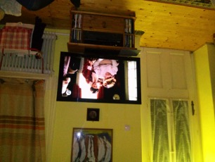
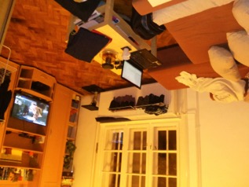
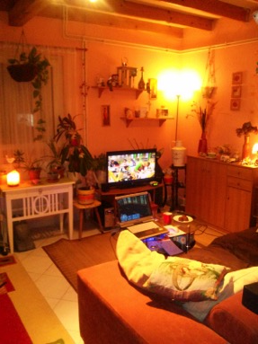
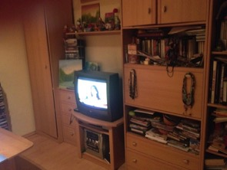
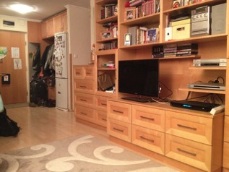
Place of TV device at home
Alone, conscious TV viewer
Switcher
In a company, conscious TV viewer

Slide 45
Linear vs. non-linear and VOD
Alone, conscious TV viewer
In a company, conscious TV viewer
Switcher
VOD is barely used, but they slightly move towards personalised TV watching.
Sometimes, after getting information a specific program via Facebook, they watch the show online.
Main barriers of VOD usage is insufficient technical background (screen size, slow internet connection)
As elderly people belong to this segment, watching TV means linear programs for them.
Linear:
VOD usage is not typical, sometimes download movies or series.
Non-linear:
VOD (HBO GO) and torrent sites are frequently visited and have a complex network to achieve the highest possible quality of in-home experience of the movies.
Smart TV applications are not used as they have no enough time and relevant content are downloaded from torrent sites.
VOD is not used.
Catch-up TV is used if looking for a specific news or content.
Segment members are critical, therefore watching only 1-2 programs, though as linear broadcast.

Slide 46
Linear vs. non-linear: drivers
Alone, conscious TV viewer
In a company, conscious TV viewer
Switcher
Only few linear TV viewers have commenced becoming an active TV viewer. Mainly Catch-up TV (RTL Most, ATV, Echo TV) is used out of VOD services, irrespective of age or segment. On the other hand Catch-up TV usage is not on regular basis, but generated by a specific event or an interesting program.
VOD (HBO GO) is used by only one respondent, as the vast majority would not pay for a movie service. This need is fulfilled by downloading illegal contents.
Moving away from linear TV viewing is a future trend. Some barriers of this change: a) current program offering is sufficient for most of viewers, b) non-linear content consumption requires pro-activity, searching and downloading attractive contents, c) more sophisticated technical knowledge and advanced devices are needed to achieve similar experience to linear TV viewing
When it comes to Catch-up TV or VOD usage, the decision tree is quite simple, viewers seek a specific content, like in case of downloaded movies or series.
Needs behind download are complex. People desire to watch latest or niche contents not provided in Hungary. Besides, downloaded contents are free of ads and it can be paused anytime when needed. Last but not least these contents are free, therefore people gain an experience of the movies without paying for it.
Non-linear viewers are up-to-date of US series, reading about them on the internet. They are able to consume these contents in English. They have the technical background for reaching any content they need.

Slide 47
Ads during TV watching
Alone, conscious TV viewer
In a company, conscious TV viewer
Switcher
Ads are not watched irrespective of segment, age or life situation. Several kinds of behaviour were found to avoid ads:
Delayed start, so ads can be skipped over later
Recording the program
Switching over to other channel
Doing other tasks, chatting with family members
Ads are not very disturbing, they do not switch over, rather do other tasks.
Ads are considered a break in TV watching
Linear: Switch over. It is an opportunity to find other program being attractive for another family member. In case of babies, ads are used for preparing for evening tasks (eating, bathing)
Ads are very disturbing for people living with a spouse, as they break the mood
Non-linear: ads broadcasted on TV channels do not reach this segment
Switch over immediately. Ads are waste of time, disturbing their content consumption.
Consciously try to avoid ads.

Slide 48
Detailed results of the quantitative phase

Slide 49
Main characteristics of the segments
By gender, age and education
Base: all respondents, n=658, Splits: Switchers: n=182, Alone, conscious TV viewers: n=228, In a company, conscious TV viewers: n=248
  SWICHERS: bit higher share of MALE and MIDDLE-AGED respondents
  ALONE, CONSCIOUS TV VIEWERS: bit higher share of FEMALE and OLDER (50-69 years old) respondents
  IN A COMPANY, CONSCIOUS TV VIEWERS: very SIMILAR TO TOTAL sample according to these variables
S01. In which year were you born?; S02. Please sign your gender. Z02. What is your highest education?

Slide 50
Main characteristics of the segments
By subjective economic status
Above the average
Average
Below the average
Base: all respondents, n=658, Splits: Switchers: n=182, Alone, conscious TV viewers: n=228, In a company, conscious TV viewers: n=248
  SWICHERS: a bit higher share of above the average economic status
  ALONE, CONSCIOUS TV VIEWERS: bit higher share of below the average economic status
  IN A COMPANY, CONSCIOUS TV VIEWERS: very SIMILAR TO TOTAL sample according to these variables
Z06. Which of the following statements describe the best your current financial situation?

Slide 51
Main characteristics of the segments
By marital status and economic activity
Base: all respondents, n=658, Splits: Switchers: n=182, Alone, conscious TV viewers: n=228, In a company, conscious TV viewers: n=248
  SWICHERS: bit higher share of respondents LIVING IN PARTNERSHIP, but not married and being ACTIVE
  ALONE, CONSCIOUS TV VIEWERS: higher share of single and divorced respondents
  IN A COMPANY, CONSCIOUS TV VIEWERS: higher share of married respondents, and a bit higher share of inactive people (being at home with children, retired)
Z03. Do you work now? Z10. What is your marital status?

Slide 52
Main characteristics of the segments
By household size and children in the household
Base: all respondents, n=658, Splits: Switchers: n=182, Alone, conscious TV viewers: n=228, In a company, conscious TV viewers: n=248
  SWICHERS: very SIMILAR TO TOTAL sample according to these variables
  ALONE, CONSCIOUS TV VIEWERS: higher share of households with one person and typically there is no child in the household
  IN A COMPANY, CONSCIOUS TV VIEWERS: typically higher-sized households, in every third household at least one child lives with the respondent
Z7. How many people live in your household? Z08. How many people live on your household who are younger than 15 years old?

Slide 53
Main characteristics of the segments
By having audio-visual devices
Base: all respondents, n=658, Splits: Switchers: n=182, Alone, conscious TV viewers: n=228, In a company, conscious TV viewers: n=248
  SWICHERS: higher share of respondents having more TV devices and smartphones in the household
  ALONE, CONSCIOUS TV VIEWERS: higher share of respondents having less smartphones in the household than the average
  IN A COMPANY, CONSCIOUS TV VIEWERS: higher share of respondents having more tablets or smartphones in the household
A01. Which of the following devices are available in your household?)

Slide 54
Main characteristics of the segments
By devices / services in the household
Service
Device
Base: all respondents, n=658, Splits: Switchers: n=182, Alone, conscious TV viewers: n=228, In a company, conscious TV viewers: n=248
  SWICHERS: higher share of cable-TV service providing more channels or TSV, VOD service and WIFI connection in he house than the average
  ALONE, CONSCIOUS TV VIEWERS: the same share of cable-TV service providing more channels or TSV, and broadband internet connection as the average
  IN A COMPANY, CONSCIOUS TV VIEWERS: lower share of cable-TV service providing more channels or TSV
A01. Which of the following services are available in your household?

Slide 55
Main characteristics of the segments
By program-selecting habits
Base: all respondents, n=658, Splits: Switchers: n=182, Alone, conscious TV viewers: n=228, In a company, conscious TV viewers: n=248
  SWICHERS: typically found the programs by surfing, 61% of the programs they selected was watched alone
  ALONE, CONSCIOUS TV VIEWERS: typically watched the programs alone and they have already decided what to watch (as they always or from time to time watch the given program)
  IN A COMPANY, CONSCIOUS TV VIEWERS: typically watched the programs in a company, they have decided before the program had started to watch it (as they always or from time to time watch the given program)

Slide 56
Main characteristics of the segments
By attitudes
PROGRAM
INFORMATION
PLATFORM
ROLE OF TV
DECISION
Base: all respondents, n=658, Splits: Switchers: n=182, Alone, conscious TV viewers: n=228, In a company, conscious TV viewers: n=248

Slide 57
Main characteristics of the segments
Dimensions based on the attitude statements
HABIT, PREFERENCE
CENTRAL ROLE
SUPPLEMENTARY ROLE
Watching TV is a routine program, there are at least 1-2 programs every day, which they follow. These programs are their favorite ones, or parts of the daily routine (e.g. news, series)
TV play a central role in leisure time, it is an integral part of daily routine, they can’t imagine their lives without a TV.
TV is only a background noise, it is turned on and goes under the respondents are doing something else. Multi-media consumption is typical.

Slide 58
Main characteristics of the segments
By dimensions based on attitude statements
Average of total sample:
  SWICHERS: to select programs based on habits or preference is less typical, many times TV plays only a supplementary role in their leisure time
  ALONE, CONSCIOUS TV VIEWERS: more likely select programs because of habit (they generally watch the given program, or it is a favorite one), TV plays a central role in their life
  IN A COMPANY, CONSCIOUS TV VIEWERS: very similar to the average

Slide 59
Main characteristics of the segments
By number of programs watched on the different channels
Total number of watched programs:
2181
807
782
592
Base: all respondents, n=658, Splits: Switchers: n=182, Alone, conscious TV viewers: n=228, In a company, conscious TV viewers: n=248
  SWICHERS: higher share of watched programs on Viasat3 and Cool and less watched programs on RTL Klub than the average
  ALONE, CONSCIOUS TV VIEWERS: almost the same patterns as the average
  IN A COMPANY, CONSCIOUS TV VIEWERS: much more watched programs on RTL Klub than the average
B02. Which of the following programs have you been watching for at least 15 minutes yesterday?

Slide 60
Main characteristics of the segments
By types of programs watched on the different channels
Total number of watched programs:
2166
801
781
584
Base: all respondents, n=658, Splits: Switchers: n=182, Alone, conscious TV viewers: n=228, In a company, conscious TV viewers: n=248
  There is no significant difference in first place, series is clearly the most popular type of programs in all the three segments. Switchers have watched more movies/films and less news or other entertaining programs than the average,
B02. Which of the following programs have you been watching for at least 15 minutes yesterday?

Slide 61
Contact

Slide 62

Contact
Sugatagi Gábor
Senior consultant
+36-1-452-3095
Gabor.Sugatagi@gfk.com
GfK Hungária Kft.

