Slide 1
Advertising Revenue Survey 2011
Hungarian Television and Radio Market
1 March 2012

Slide 2
We prerared the Advertisement Cake as of 2011
The data used to determine the size of the advertising market was provided by the members of MEME* (including television and radio companies)
The data was provided by 52 television channels and 4 radio stations
Seven new television companies took part in the survey and one radio stopped broadcasting since last year
The data collection and analysis was performed by Ernst & Young Advisory
All the data have been destroyed after the analysis
*MEME: The Association of the Hungarian Electronic Broadcasters

Slide 3
The number of data-providers increased with seven televisions and decreased with one radio
Television channels:
Animax
ATV
AXN
Cartoon
Comedy Central
Cool
Spektrum Home (Deko)
Discovery
Disney Channel
DoQ
Duna Tv
Film+
Film+2
Filmmúzeum
Fishing&Hunting
Hallmark/Universal Channel
Hálózat Tv
Hír Tv
LifeNetwork
MGM
Minimax
Movies 24
MTV Networks Magyarország
MTV m1
MTV m2
National Geographic
OzoneNetwork
Prizma (Poen)
Reflektor
RTL Klub
Sorozat+
Spektrum
Sport 1
Sport 2
Sport M
SportKlub
Story 4
TV Paprika
Tv2
Viasat6
Viasat3
Viva
Zone Club
Zone Reality
Zone Romantica
New data providers:
FEM3
Music Channel
Muzsika
Nóta Tv
PRO4
PV TV
Story5
Radio stations:
Juventus
Class FM
Magyar Rádió
NEO FM

Slide 4
We calculated the net-net revenue
Net-net revenue – revenue after deducting discounts and commissions
No barter revenue included
No other revenue data were included (such as premium rate calls or text message charges, revenues from events or products with own brand)

Slide 5
The results demonstrate the preliminary expectations
Based on the calculation of Ernst & Young the total revenue of the television advertising market in 2011 is
HUF 54 901 million
The market share of the participating* television companies is approx. 99%.
The total revenue of the radio advertising market in 2011 is
HUF 4 618 million
The market share of the participating* radio stations is approx. 75 %.
*2-26h – complete day, A4+ - All the channels who were surveyed excluding VIDEO/DVD

Slide 6
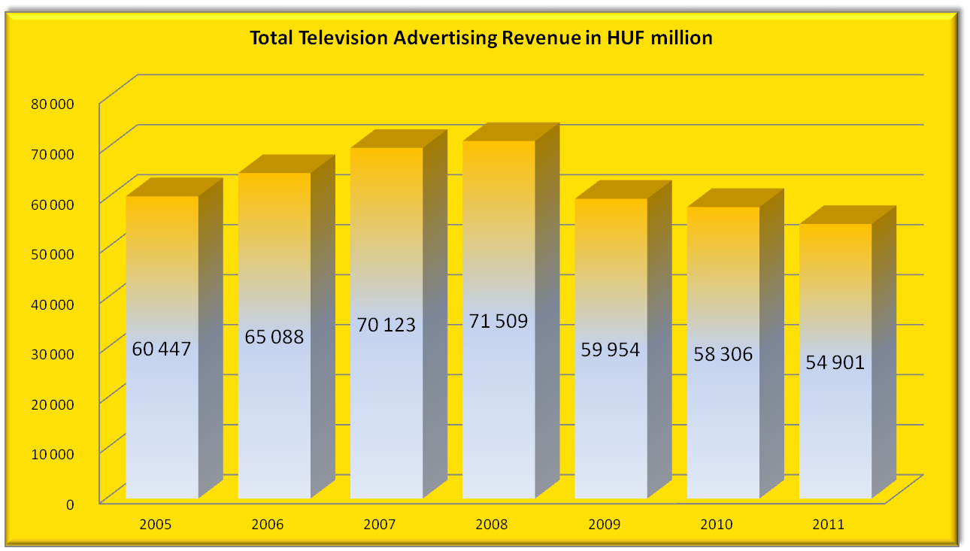


Television advertising revenue is still decreasing
-16%
- 3%
8%
2%
- 6%
8%

Slide 7
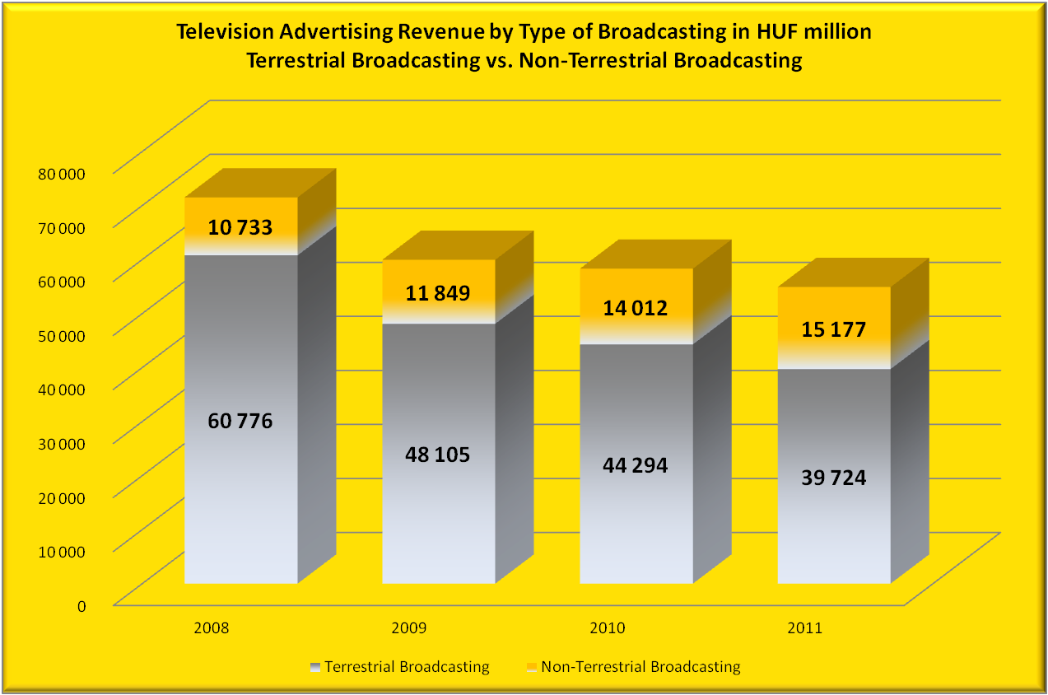
Advertising revenue of the terrestrial broadcasting televisions decreased with 10%
∑ 71 509
∑ 59 954
∑ 58 306
∑ 54 901
10%
18 %
8 %
21 %
8 %
10 %

Slide 8
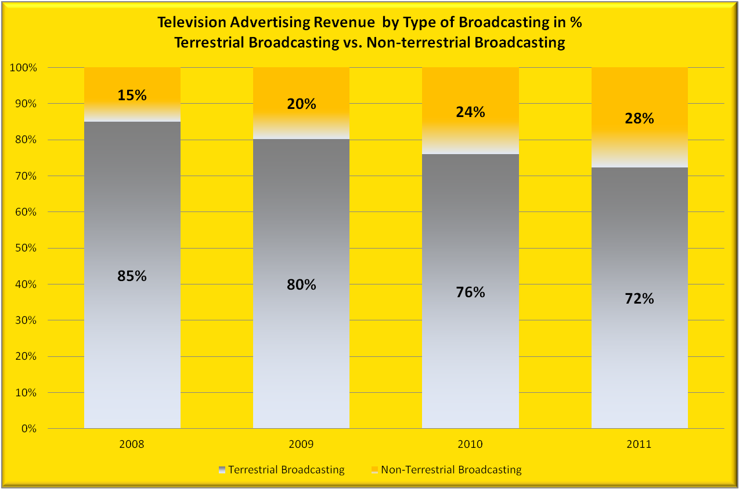
Share of non-terrestrial broadcasting revenue has increased in the advertisement cake
10 733
11 849
14 012
15 177
60 776
48 105
44 294
39 724

Slide 9
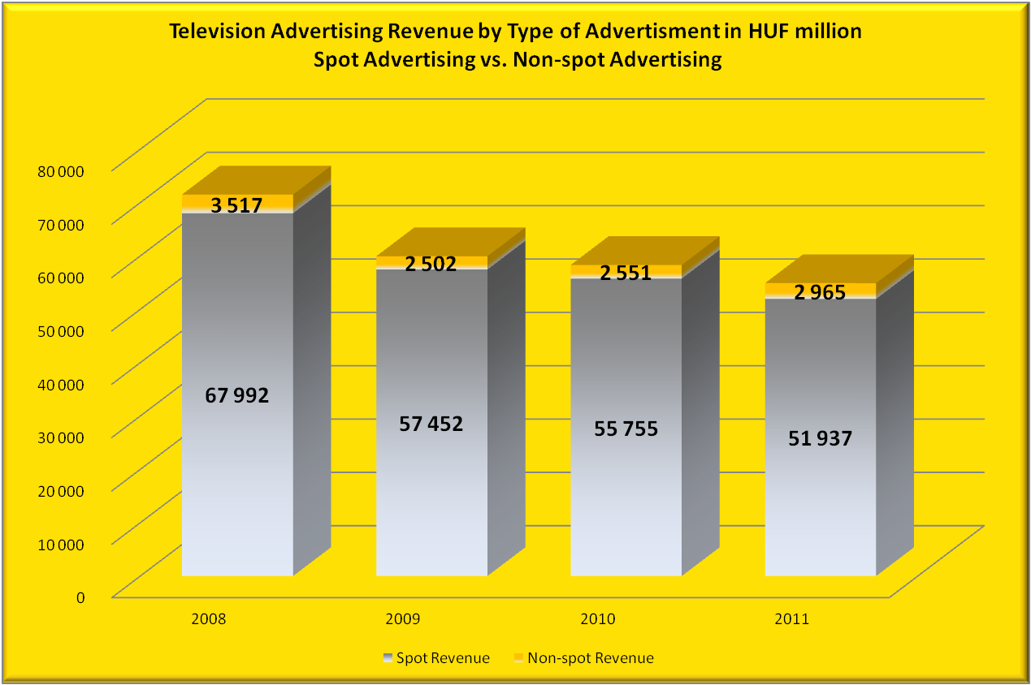
Non-spot advertising revenue increased by 16% compared to previous year
∑ 71 509
∑ 59 954
∑ 58 306
∑ 54 901
29%
2 %
16 %
16 %
3 %
7 %

Slide 10
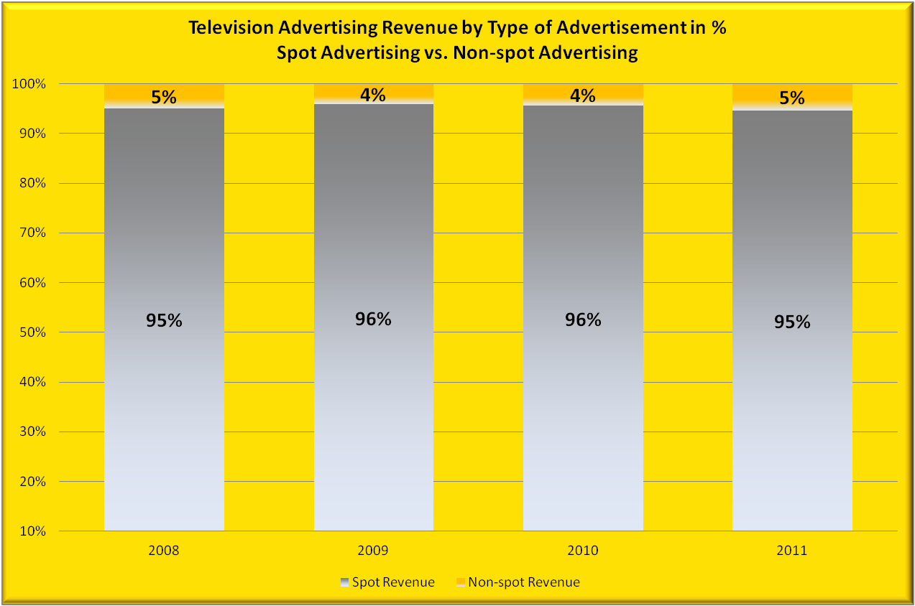
Non-spot advertising revenues have a 5% share in the advertisement cake this year
3 517
2 502
2 551
2 965
67 992
57 452
55 755
51 937

Slide 11
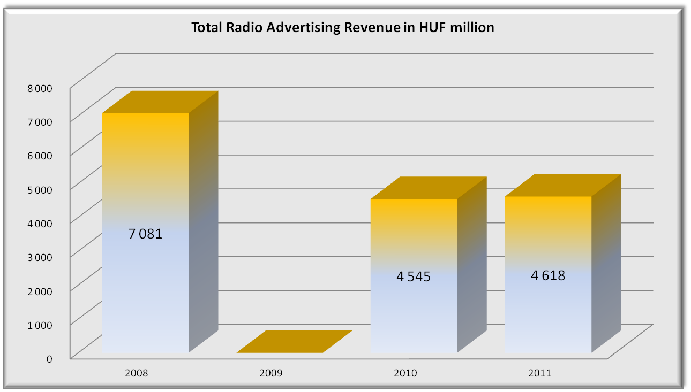
The radio advertising revenue has increased with 2% since the last year
2 %
Data is not available in 2009,

Slide 12
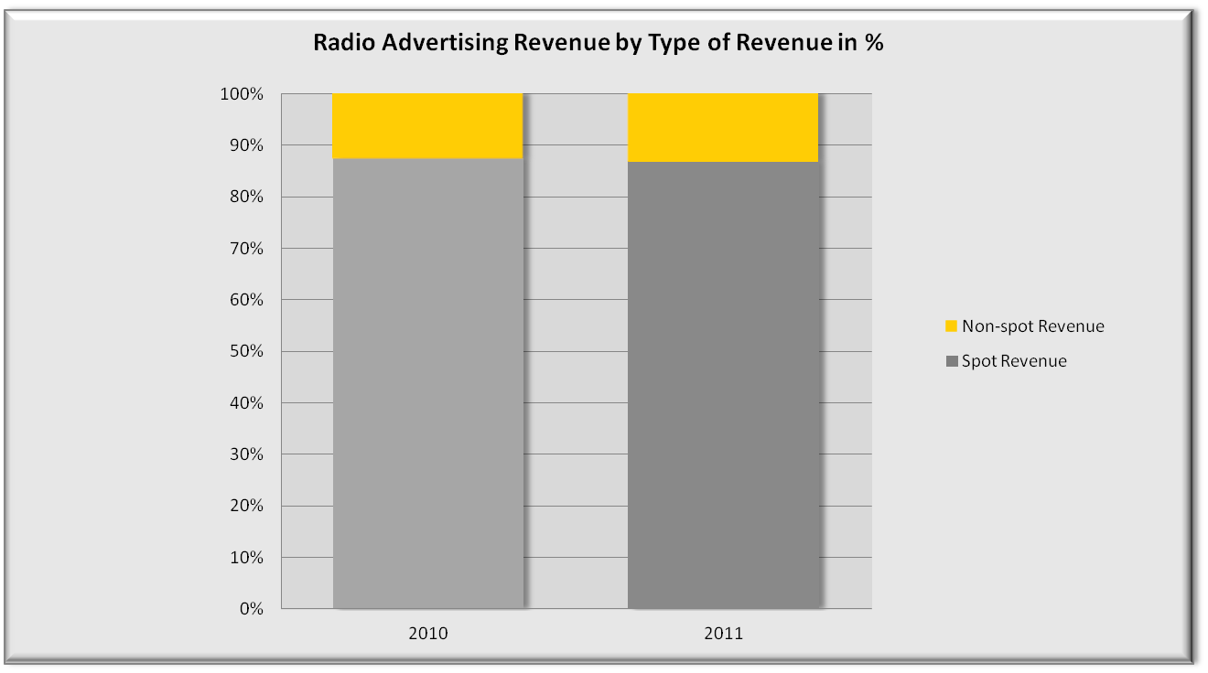
The distribution of radio advertising revenue by type remains the same compared to last year
13 %
13 %
573
614
87 %
87 %
3 972
4 004

Slide 13
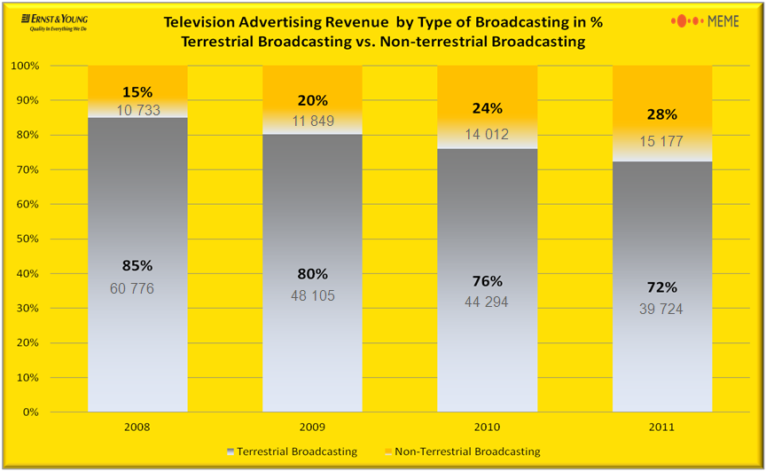
The amount of advertising revenue does not depends on the market share.
Market share of non-terrestrial broadcasting televisions:
54,7%*
Market share of terrestrial broadcating televisions:
44,6%*
The advertising revenue share of the terrestrial broadcasting televisions who are participating in the survey is 72% meanwhile based on the market share they cover the 54,7%* of the market.
The advertising revenue share of the non - terrestrial broadcasting televisions who are participating in the survey is 28% meanwhile based on the market share they cover the 44,6%* of the market.
*2-26h – complete day, A4+ - All the channels who were surveyed excluding VIDEO/DVD

Slide 14
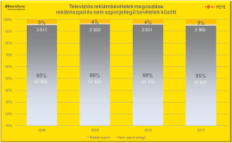
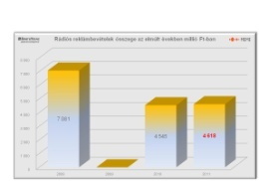
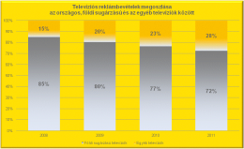
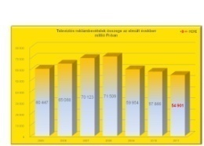
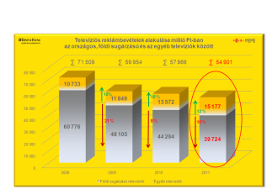
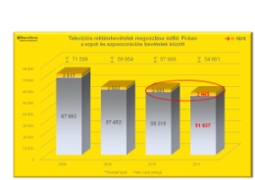
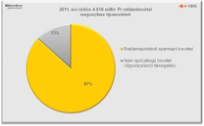
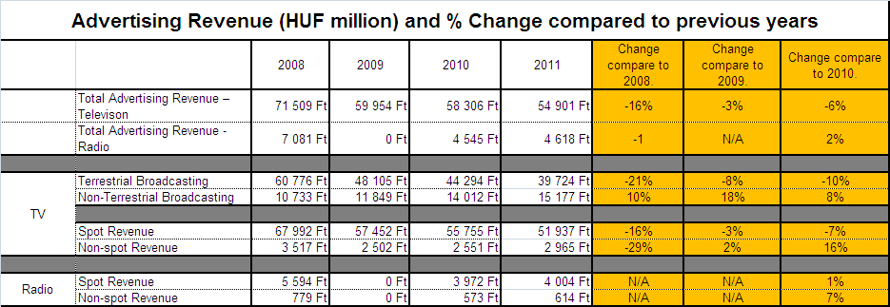
In 2011 the advertising revenues altogether has decreased.
In 2011 the advertising revenues altogether has decreased, while the advertising revenue of the radio stations, and the non - terrestrial broadcasting televisions has increased, and the non-spot advertising revenues in the advertisement cake has increased more compared to the previous year !

Slide 15
Thank You for Your Attention!
Notes:
If using the graphic on the title slide the same should be used on the thank you slide. If using a picture in the Input area of the Beam in the title slide, the same or different but related picture can be used on the thank you slide.

